Slide 1
FIT Program Charters
Betsy Wymer, DNP, RN, CV-BC
SVS PSO Director of Quality

Slide 2
Identifying a QI Project
Use Your VQI Reports
VQI Quality Regional Quality Reports (Spring and Fall)
VQI Best Practice Dashboards
Center Opportunity Profile for Improvement (COPI) reports
Center level
Physician level
Analytics Engine Reports
SVS Guidelines and Recommendations

Slide 3
Starting a QI Project
Identify Team members
FIT Mentor
Project lead
Project sponsor
Quality expert
Front line staff
Stakeholders
Notes:
Having the right team members is imperative for a successful project. An inter-disciplinary team is a must. The team should consist of stakeholders, people the project will impact, but can also consist of someone who can be used as a reference for quality tools, etc.
Project lead – This is usually the data manager
Project sponsor – someone who has executive authority, who is senior management or has direct link to senior management, who can provide resources and help the team overcome barriers.
Quality expert – maybe the project lead, but if not. This person can keep the team on track by referring to the charter providing a methodology, and knowledge of QI tools (charts, etc).
Front line staff – these will be the worker bees. They know their workflow and can give insight.
Stakeholders – other physicians, dept that will be impacted or needed for background knowledge. The patient is a primary stakeholder – don’t forget this!

Slide 4
Starting a QI Project
Three dimensions of quality defined by HRSA
Structure
Process
Outcome
Notes:
HRSA defines three dimensions of healthcare quality, which are:
Structure, which represents the attributes of settings where care is delivered
Process, whether or not best medical practices are followed.
Outcome, which is the impact of the care on health status.

Slide 5
Starting a QI Project
What are the desired improvements?
Relevant and specific
Measurable
Accurate and achievable
Feasible and timely
Realistic
Notes:
As you begin a QI project, consider this question: What are the desired improvements and are they relevant, measurable, accurate, and feasible?
Relevant and based on a condition that frequently occurs and/or has a great impact on the patients at your facility
Measurable and can be realistically and efficiently measured with the facility’s finite resources
Accurate and based on accepted guidelines or developed through formal group decision-making methods
Feasible and can realistically be improved given the capacity of the organization’s clinical services and patient population

Slide 6
Selecting a QI Model
Use a single model or combination
Categorize and identify potential changes
Already been proven effective
Provides guidance on approach to change
Improves quality care
Notes:
-Using quality improvement (QI) models, either alone or in combination, is an effective approach for categorizing potential changes to an organization’s system and identifying changes that worked in other similar settings.
-QI models help an improvement team to focus on changes that have already proven to be effective, and they also provide guidance on different ways to approach change.
-QI models successfully shape quality program infrastructures and guide QI activities to improve overall quality care for various patient populations.

Slide 7
QI Models
Variety of QI Models
Select one or combination best suits project
Care model
Lean model
Model for Improvement (PDSA)
FADE
Six Sigma or Lean Six Sigma
Notes:
There are a variety of QI models. Select the one model or a combination of QI models that best suits the Charter or project. Some examples of QI models are the Care Model, the LEAN Model, the Model for Improvement (PDSA), the FADE model and the Six Sigma (aka Lean Six Sigma).
Care Model: There are six fundamental aspects of care identified in the Care Model, which creates a system that promotes high-quality disease and prevention management. It does this by supporting productive interactions between patients, who take an active part in their care, and providers, who have the necessary resources and expertise.
Lean Model: This model defines value by what a customer (i.e., patient) wants. It maps how the value flows to the customer (i.e., patient), and ensures the competency of the process by making it cost effective and time efficient.
Model for Improvement: This model focuses on three questions to set the aim or organizational goal, establish measures, and select changes. It incorporates Plan-Do-Study-Act (PDSA) cycles to test changes on a small scale.
FADE: There are four broad steps to the FADE QI model:  Focus—define process to be improved  Analyze—collect and analyze data  Develop—develop action plans for improvement  Execute—implement the action plans, and Evaluate—measure and monitor the system to ensure success
Six Sigma or Lean Six Sigma: Six Sigma is a measurement-based strategy for process improvement and problem reduction.

Slide 8
Quality Improvement Charter

Slide 9
Quality Improvement Charter

Slide 10
Problem Statement
Be clear and concise
Be specific
Measurable
Be relevant
Example:
“There is inadequate follow up among patients with peripheral artery disease (PAD) who have undergone lower extremity revascularization at xxxxx center. Using VQI data, a review of all patients who had lower extremity revascularization for PAD in 2018 demonstrated that 29% (N=161) of patients were lost to follow up and did not have one year follow up (9 – 21 months window). VQI data demonstrates that loss to follow up after revascularization for PAD is associated with increased mortality.”

Slide 11
Scope
Scope
What areas do you want to improve and consider over what timeframe?
Example
“This project will include patients undergoing lower extremity revascularization within the xxxxxx center care areas. The project will require participation from vascular specialists performing lower extremity revascularization (open and endovascular) including vascular surgery, interventional cardiology, and interventional radiology, inpatient and outpatient physician extenders, EPIC clinical support, and administrative/scheduling reinforcements.”

Slide 12
Deliverables
Deliverables
What new processes will you need to deliver in order to achieve your goal?
Examples
1. MD Project Leader will address all physicians performing lower extremity revascularization regarding appropriate follow up
2. MD Project leader and project members will contact all those lost to follow up via telephone to identify barriers to follow up (e.g. socioeconomic factors, geographic factors, different vascular provider, etc).
3. All patients lost to follow up with receive formal letter draft by the MD Project Leader requesting follow up appointment as appropriate.
4. Survey results will be analyzed to identify key factor contributing to loss of follow up.
5. Results will be analyzed in 3-4 months to identify the percent of patients who were initially lost to follow up who have returned to be seen by their vascular specialist.
6. Outcomes of patients will be tracked after following up to assess for recurrence of symptoms, compliance with medical therapy, results of imaging, and necessary reinterventions
7. Effort (time) in trying to reach patients will be tracked by the QI team
8. Epic analytics will track clinic visits, imaging, procedures, and downstream revenue generated from decreasing lost to follow up

Slide 13
Key Metrics
Outcome Metrics
How will you know the project is successful?
1. Identify factors associated with loss to follow up
2. Follow up rates among those lost to follow up
3. Follow up rates among those with PAD after revascularization
Process Metrics
How will you ensure the implemented interventions are being completed?
1. Telephone calls to those lost to follow up and mailed letters
2. Quarterly performance report to clinical teams

Slide 14
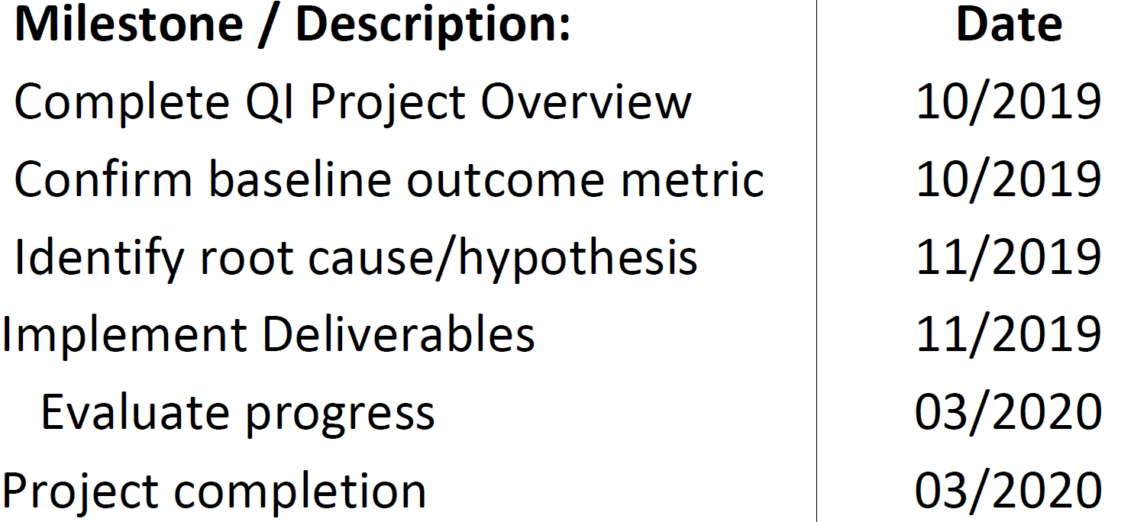
Milestones
Make sure to give yourself enough time
This can roll into another year
Be specific with target dates

Slide 15
Review and Submit Your Charter
Review your charter
Meet with your Mentor for a final review
Make edits/updates
Finalize
Submit your charter
Submit to bwymer@svspso.org
Participation Points
One charter per center per year = 2 participation points
Feel free to submit more than one charter BUT only receive credit for one charter per year per center

Slide 16
Helpful Hints
Feel free to use same charter for multiple centers
Must submit one charter per center
Don’t strive for 100%, make it attainable
Start small, consider 5-10% difference
Use your resources – https://www.vqi.org/quality-improvement/
When in doubt, ask

