Slide 1
PSO Reporting
VQI Regional Quality Report
Drilling Into Semi Annual Regional Reports
Leila Mureebe, MD, MPH
SVS PSO Associate Medical Director
Division of Vascular and Endovascular Surgery
Duke University Health Center, Durham NC
Chief Health Informatics Officer
Mid-Atlantic Region, Veterans Health Administration
June 13th, 2023
Notes:
Good afternoon, welcome everyone and thank you for being here. The focus of this talk is the VQI Regional Quality Report. By the end of this talk you’ll have a better idea about what’s contained in these reports, how to drill-down and interpret your data, and hopefully a better sense for how you can use the reports to facilitate and drive quality improvement at your institution. [click]

Slide 2
Overview
Background
Structure
  Report Components
  Tracking Your Cases
  Drill-Down
Interpretation
Notes:
As an overview, we’ll start with some brief background on the report. [click]
From there we’ll delve into the structure of the reports. We’ll talk about the various report components, provide important information on tracking your cases, and how to use the reports to drill-down into your data. [click]
And finally, we’ll conclude the talk with a few notes on interpreting the reports and how you can look for areas where your center is doing well or possible areas for improvement. [click]

Slide 3
Background
Cornerstone of VQI regional quality group meetings
Targeted, comparative results and benchmarks
  Currently 27 key measures
Peri-operative outcomes and long-term (9-21 month) outcomes
  Process measures and complications
2 reports per year (Spring and Fall)
Notes:
The VQI Regional Quality Report is of course the cornerstone of VQI regional quality group meetings. [click]
It provides targeted, comparative results and benchmarks for a variety of procedures. There are currently 27 key measures given in the report. [click]
The report contains both peri-operative and long-term (9-21 month) outcomes - both process measures and complications. [click]
There are 2 reports per year, which correspond to the Spring and Fall VQI regional quality group meetings. [click]

Slide 4
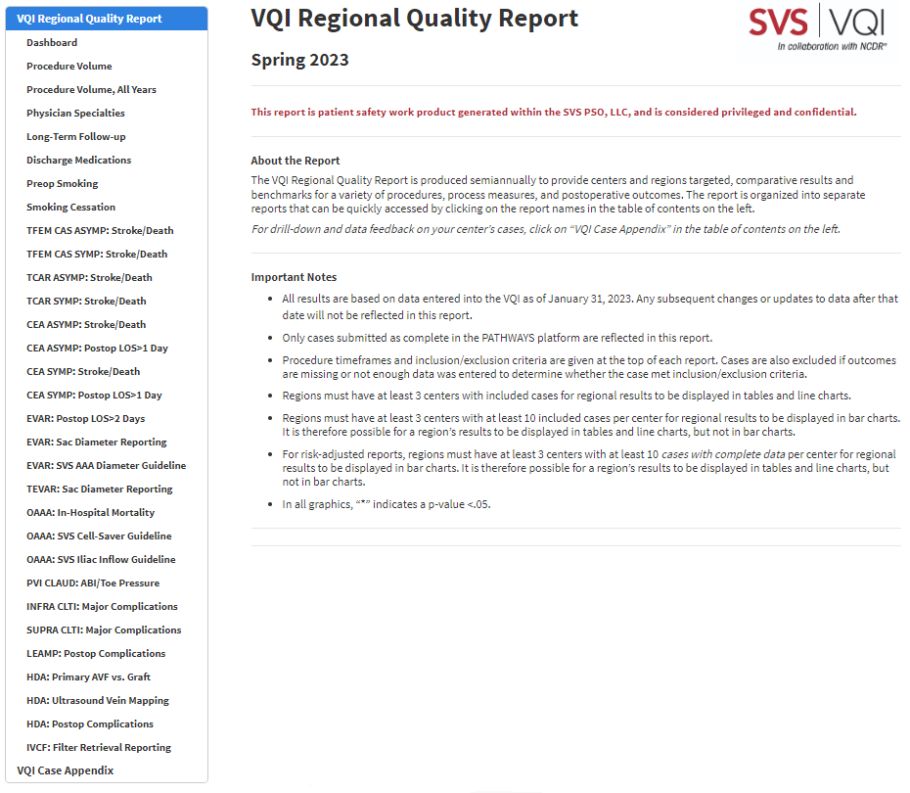
Structure
Table of Contents for Navigation
High-level summary of results, procedure volume, and physician specialty
Reports for 27 key measures
Notes:
Let’s now turn to the structure of the regional report. The regional report is an interactive report designed to be opened and manipulated in a web browser. When you open the report, a table of contents is given on the left, as pictured here for the Spring 2023 report. [click]
The table of contents can be used to navigate to each individual report. A total of 31 reports can be accessed from the table of contents. [click]
The first four reports in green provide a high-level summary of results, procedure volume information, and physician specialty information. But the real meat of the regional reports is contained here in blue. These reports reflect the 27 key measures given in the regional report. Each of these reports has the same overall structure and the same 5 basic components. [click]

Slide 5
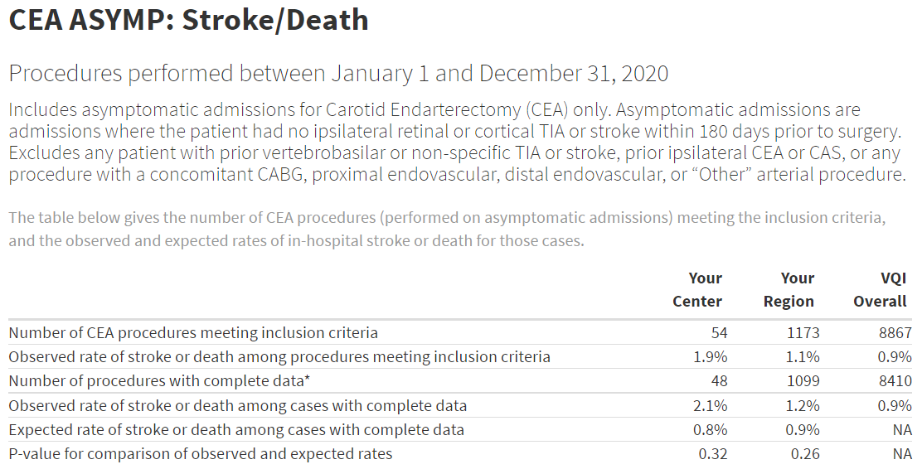
Components
(1) Report Description and (2) Comparison Table
Report Description
Procedure Timeframe
Inclusion/Exclusion Criteria
Outcome definition
Comparison Table
Risk-adjusted Assessment
Notes:
The first 2 components are the report description and the comparison table. [click]
The report description includes the procedure timeframe and inclusion/exclusion criteria for the report, as well as the outcome definition. [click]
The comparison table provides results for your center, your region, and the VQI overall. [click]
Here we can see the center’s observed rate of stroke or death compared to their region and the VQI overall. Note that the region and VQI Overall rates are about the same, but the center’s rate is about double that of the region and VQI overall. Now, the center may look at this comparison and reply “Of course our rate is higher – we do more complex procedures on sicker patients, so we expect our rate to be higher than the region and the VQI overall.” To respond to such concerns, there is a risk-adjusted assessment provided in the comparison table. [click]
The last 4 rows of the comparison table pertain to the risk-adjusted assessment. To provide a risk-adjusted assessment, a statistical model that accounts for patient characteristics like age, gender, race, BMI, comorbidities, medication, and stroke and vascular history is used to estimate an expected rate for the center. [click]
Procedures with complete data are procedures that have non-missing data for all the factors used in the statistical model, so the number of such procedures is given in this row. Note that 48 of the 54 procedures had complete data for risk adjustment, so this means 6 of the center’s cases were not included in the risk-adjusted assessment. [click]
Among the 48 cases with complete data, we can see the observed rate was 2.1% and the expected rate was 0.8%. Since 2.1/0.8 ~= 2.6, this means the center’s observed rate is about 2.6 times higher than what we would expect given their patient and procedure characteristics. [click]
And finally, there is a p-value for comparing observed and expected rates. But before we talk about what that value of 0.32 means, let’s get a little background on p-values. [click]

Slide 6
Components
P-value
  Mathematical probability that ranges from 0 to 1
  In regional reports, p-values are used to test whether a given rate differs significantly from some reference rate.
  Consider the following questions:
    Is your center’s rate different than your region’s rate?
    Is your region’s rate different than the overall VQI rate?
    For risk-adjusted reports, is your center’s observed rate different than your center’s expected rate?
    For risk-adjusted reports, is your region’s observed rate different than your region’s expected rate?
Statistical Test
P-value
If P-value < 0.05, the answer is affirmative, and the result is statistically significant
There is a high level of confidence that the observed difference between the given rate and the reference rate is not due to chance alone
Notes:
A p-value is a mathematical probability that ranges from 0 to 1. [click]
In the regional reports, p-values are used to test whether a given rate differs significantly from some reference rate. For example, consider the following questions:
Is your center’s rate different than your region’s rate?
Is your region’s rate different than the overall VQI rate?
For risk-adjusted reports, is your center’s observed rate different than your center’s expected rate?
For risk-adjusted reports, is your region’s observed rate different than your region’s expected rate? [click]
To answer each of these questions, a statistical test is performed, and a p-value is generated. [click]
If the p-value is less than 0.05, the answer is affirmative, and we say the result is statistically significant. [click]
In other words, there is a high level of confidence that the observed difference between the given rate and the reference rate is not due to chance alone. [click]
So let’s now return to the question of whether this center’s observed rate is different than the center’s expected rate. [click]

Slide 7
Components
(1) Report Description and (2) Comparison Table
Comparison Table
Notes:
Looking at the comparison table, we see the p-value is 0.32, which is not less than 0.05. Given this, we say the difference is NOT statistically significant. [click]
That is, the difference we see between the center’s observed and expected rates could be due to chance alone (for example, it’s possible the center was unlucky). [click]
A similar p-value is provided to compare the region’s observed and expected rates. We see the region’s observed rate of 1.2% is fairly close to the region’s expected rate of 0.9%, and unsurprisingly, the result is again NOT statistically significant. Now, the last 4 rows of this comparison table pertain to risk-adjustment, so for non-risk-adjusted reports, only the first 2 rows are displayed [click]

Slide 8
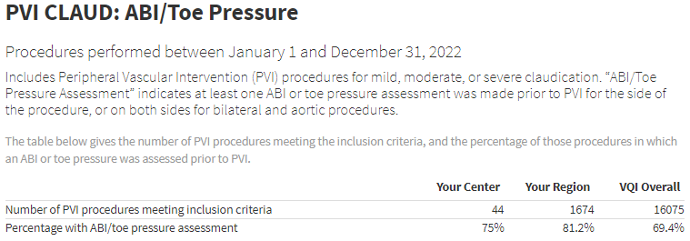
Components
(1) Report Description and (2) Comparison Table
Comparison Table
    Is your center’s rate different than your region’s rate?
    Is your region’s rate different than the overall VQI rate?
Notes:
As seen here for the PVI ABI/Toe Pressure Report. For these comparison tables, we’re more interested in the 2 questions we saw previously. [click]
Is your center’s rate different than your region’s rate? [click]
And is your region’s rate different than the overall VQI rate? To answer these questions, we again perform statistical tests and generate a p-values. Note that the p-values are NOT displayed in the comparison table for non-risk-adjusted reports. Instead, the statistical significance of these tests is expressed graphically in the center and regional variation charts we’ll discuss shortly. [click]

Slide 9
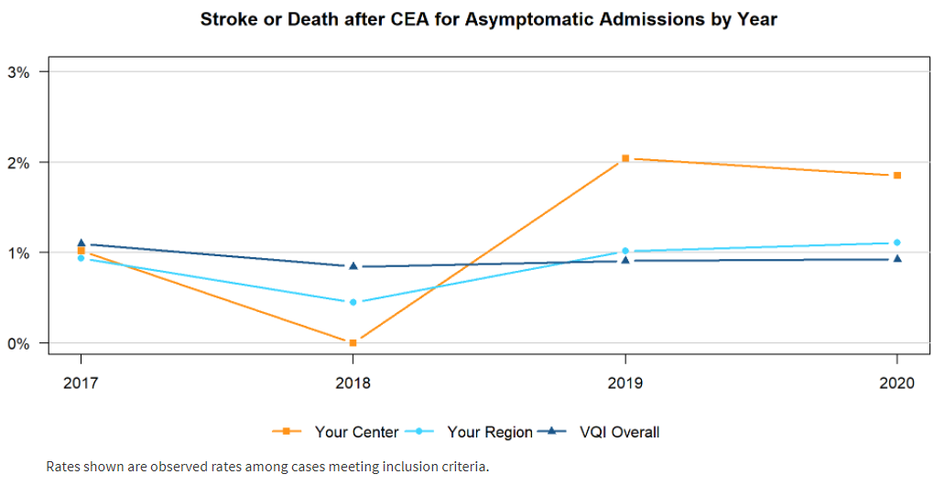
Components
(3) Line Chart
Yearly rates over a 4-year timeframe
Notes:
But before we move on to center variation charts, the third component we need to discuss is the line chart. The line chart provides a longitudinal trend of yearly rates over a 4-year timeframe for your center, region, and VQI overall. [click]
As noted in the chart, the rates shown are the observed rates among cases meeting inclusion criteria given in the comparison table. [click]
Note the comparison table represents only the most recent year of data, so the last 3 points plotted on this chart correspond to the observed values given in the comparison chart, as shown here. [click]

Slide 10
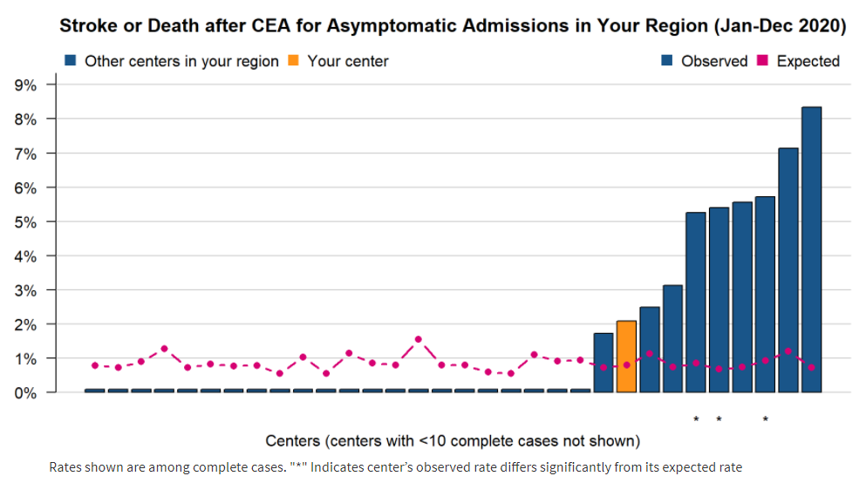
Components
(4) Center Variation Chart
Center rates within your region
Notes:
The fourth component is the center variation chart. The center variation chart provides blinded center rates within your region. The idea behind this chart is to give you a sense of how center rates vary within your region. [click]
First, note that centers with less than 10 complete cases are not shown in the center variation chart, so it’s possible that your center is not displayed in the chart. [click]
Second, the rates shown are among complete cases, as noted in the footnote. [click]
And indeed, if we look back at the comparison table, we see this center’s value of 2.1% is reflected in the center variation chart. [click]
Expected rates are given in purple [click]
And looking again at the comparison table, we see this center’s expected rate of 0.8% is reflected in the center variation chart. [click]
As given in the footnote, an asterisk indicates that a center’s observed rate differs significantly from its expected rate. In this region we see there were 3 such centers, all of which had an observed rate that was significantly higher than the expected rate. [click]

Slide 11
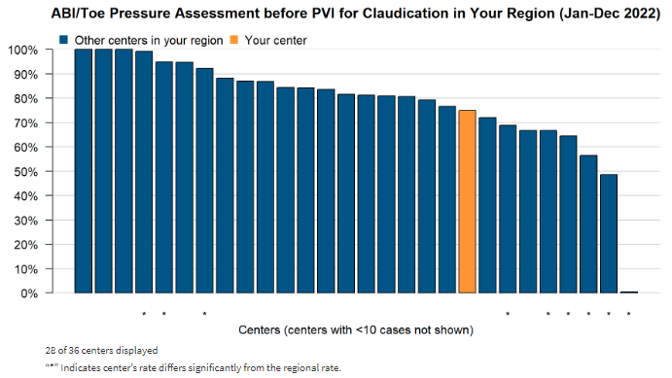
Components
(4) Center Variation Chart
Center rates within your region
    Is your center’s rate different than your region’s rate?
Notes:
For non-risk-adjusted reports, the center variation charts look very similar, though of course there are no expected values to display. Here we see the center variation chart for the PVI ABI/Toe Pressure Report. [click]
The asterisk now has a different interpretation, as given by the footnote. We see now that an asterisk indicates that a center’s rate differs significantly from the regional rate. [click]
And this is where we return to the comparison table and the question of whether the center’s rate is different than the region’s rate. While the p-value is not displayed in the comparison table, an asterisk is displayed in the center variation chart if the p-value is less than 0.05 and the difference is statistically significant. [click]
In this region we see there were 9 such centers, 3 (on the left) had ABI/Toe Pressure rates that were significantly higher than the regional rate, and 6 (on the right) had ABI/Toe Pressure rates that were significantly lower than the regional rate. [click]
Since there is no asterisk for this center, the center’s rate of 75% was not significantly different than the regional rate of 81.3%. [click]

Slide 12
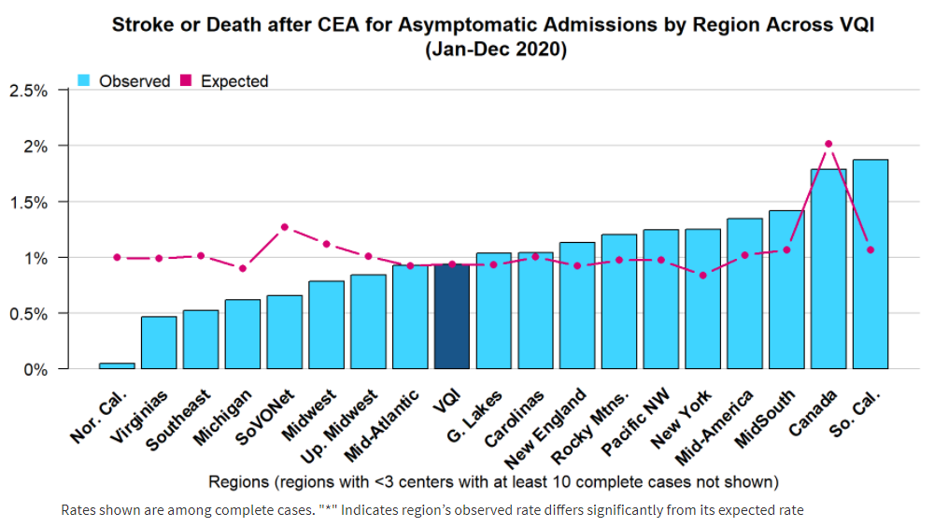
Components
(5) Regional Variation Chart
Regional rates across VQI
Notes:
The final fifth component is the regional variation chart. The regional variation chart provides regional rates across the VQI. The idea behind this chart is to give you a sense of how regional rates vary across the VQI. [click]
First, note that regions with less than 3 centers with at least 10 complete cases are not shown in the regional variation chart, so it’s possible that your region is not displayed. [click]
As with the corresponding center variation chart we saw, the rates shown are among complete cases and the expected rates are given in purple. [click]
As given in the footnote, an asterisk indicates that a region’s observed rate differs significantly from its expected rate. [click]
Since there are no asterisks here, no region had an observed rate that was significantly different than its expected rate. [click]

Slide 13
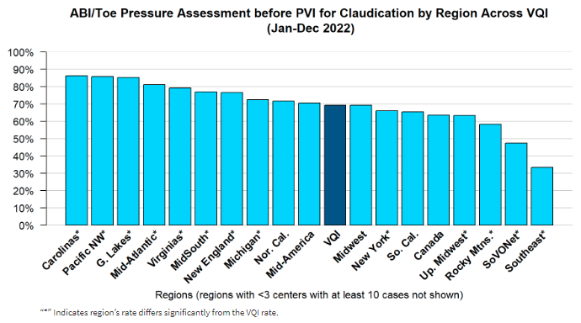
Components
(5) Regional Variation Chart
Regional rates across VQI
    Is your region’s rate different than the overall VQI rate?
Notes:
For non-risk-adjusted reports, the regional variation charts look very similar, though of course there are no expected values to display. Here we see the regional variation chart for the PVI ABI/Toe Pressure Report. [click]
The asterisk now has a different interpretation, as given by the footnote. We see now that an asterisk indicates that a region’s rate differs significantly from the overall VQI rate [click]
Which can answer the question of: Is your region’s rate different than the overall VQI rate? [click]
In this report, we see there were 7 regions (on the left) with an ABI/Toe Pressure rate that was significantly higher than the overall VQI rate, and 5 regions (on the right) with an ABI/Toe Pressure rate that was significantly lower than the overall VQI rate. [click]

Slide 14
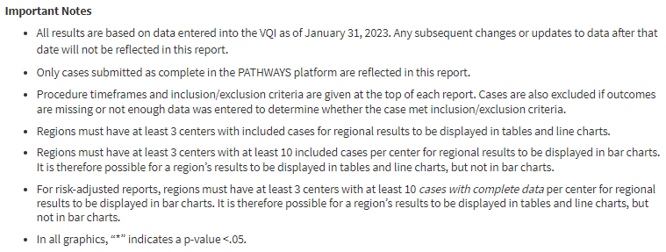
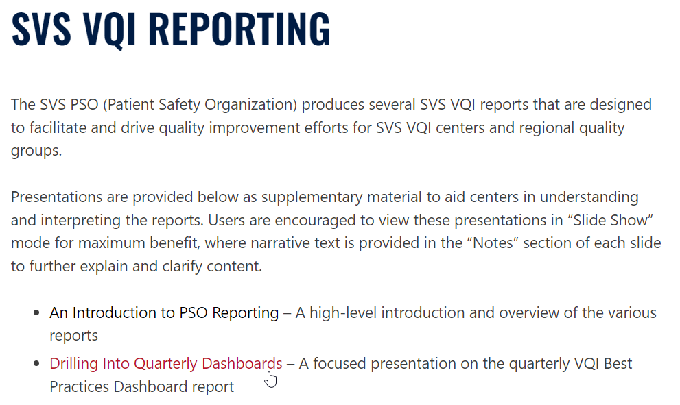
Tracking Your Cases
Reasons Why the Number of Cases in the Reports May Not Match What You Expect
(1)
(2)
(3)
https://www.vqi.org/resources/reporting
Notes:
So now that we’ve seen the 5 basic report components, I’d like to briefly mention the important topic of tracking your center’s cases. Centers may have questions about why certain cases were or were not included in the reports, so we’ll briefly reference the reasons why the number of cases in the regional reports may not match what you expect, as outlined in the “Important Notes” section of the report. [click]
These 3 reasons were discussed extensively in last year’s presentation on the quarterly VQI Best Practices Dashboard and are identical for regional report. [click]
So, for the sake of brevity, we’ll reference last year’s presentation for details, which is available on the VQI Reporting website as shown here. From the website you can download the PowerPoint slide-deck, where slides 18-24 focus exclusively on this topic. [click]

Slide 15
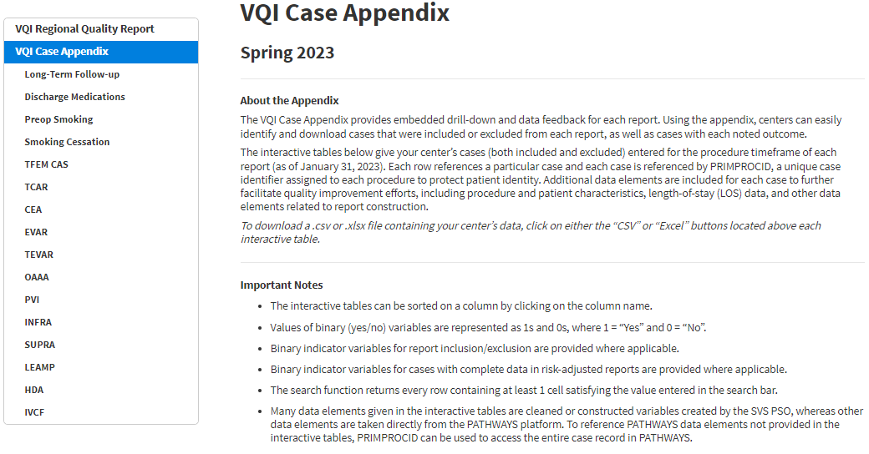
Drill-Down
16 interactive drill-down tables associated with 11 procedure registries
Identify which cases were included/excluded in each report
Identify why cases were included/excluded in each report
Identify cases with outcomes of interest
Notes:
And that brings us to the very important topic of drill-down. At some point, you’re going to be interested in identifying cases that were included or excluded from a report. And more importantly, you’re going to be interested in identifying cases that had complications, cases with extended length-of-stay, or cases not receiving discharge medications, etc. To answer these questions, embedded drill-down functionality is included in the form of the VQI Case Appendix. [click]
The case appendix consists of 16 interactive drill-down tables associated with 11 VQI procedure registries. [click]
The case appendix has 3 primary functions as shown here. [click]
Let’s now look at some of these drill-down tables to get a better idea of the functionality provided. [click]

Slide 16
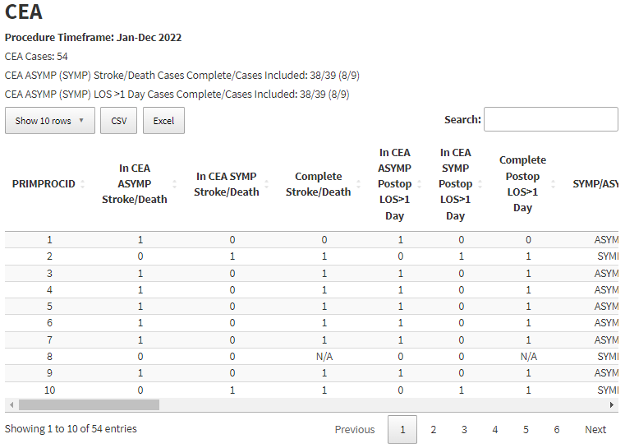
Drill-Down
39 cases in CEA ASYMP: Stroke/Death report,
38 cases with complete data
54 – 39 – 9 = 6
So, 6 cases were excluded from both
(1) CEA ASYMP: Stroke/Death
and
(2) CEA SYMP: Stroke/Death
Total # of cases in the procedure timeframe submitted prior to the data cut date
9 cases in CEA SYMP: Stroke/Death report,
8 cases with complete data
Change the # of rows for display
Download the table as .csv or .xlsx file
Click to page thru your cases
Notes:
Here we see the CEA drill-down table. [click]
First, note the total number of cases in the procedure timeframe given at the top, and that this matches the number of entries (rows) in the table. [click]
Every row in the table represents a case, and cases are indexed by PRIMPROCID, a unique case identifier assigned to each procedure to protect patient identity. [click]
The default display is 10 rows per case, but you can change the number of rows displayed with this button. [click]
You can also click these buttons to page thru your cases. [click]
These buttons allow you to download either a .csv or .xlsx file containing all the data in the interactive table. [click]
This line tells you that 39 cases were included in the CEA ASYMP: Stroke/Death report, 38 of which had complete data for risk-adjustment. Similarly, 9 cases were included in the CEA SYMP: Stroke/Death report, 8 of which had complete data for risk-adjustment. [click]
Since there were 54 CEA cases total, this means there were 54 – 39 – 9 = 6 cases excluded from both CEA ASYMP: Stroke/Death and CEA SYMP: Stroke/Death. [click]
The next line provides figures for the CEA Postop LOS>1 Day reports, note the numbers are identical for this center. [click]

Slide 17
Drill-Down
Binary indicators for report inclusion
(1 = yes, 0 = no)
Indicator for Complete Data
(1 = yes, 0 = no, N/A = Not Applicable)
Notes:
You can tell what specific cases were included or excluded in each report by using the binary indicators provided in the drill-down table. [click]
For example, here we see binary indicators for the CEA Stroke/Death reports. [click]
These cases were included in the CEA ASYMP: Stroke/Death report (In CEA ASYMP Stroke/Death = 1). [click]
These cases were included in the CEA SYMP: Stroke/Death report (In CEA SYMP Stroke/Death = 1). [click]
This case was not included in either report (In CEA ASYMP Stroke/Death = 0 and In CEA SYMP Stroke/Death = 0). [click]
There are also indicators for complete data that tell you whether the case had complete data for risk-adjustment. [click]
For example, we can see this case was included in the CEA ASYMP Stroke/Death report but was not included in the risk-adjusted assessment of the report because it did not have complete data (Complete Stroke/Death = 0). [click]
This case was included in the CEA ASYMP Stroke/Death report and also the risk-adjusted assessment because it had complete data for risk-adjustment (Complete Stroke/Death = 1). [click]
And finally, this case was excluded from both Stroke/Death reports, so it doesn’t make any sense to talk about whether the case had complete data for risk-adjustment. The value of Complete Stroke/Death for this case is therefore N/A (not applicable). [click]
As we see here, similar indicators are also provided for the Postop LOS>1 Day reports. [click]

Slide 18
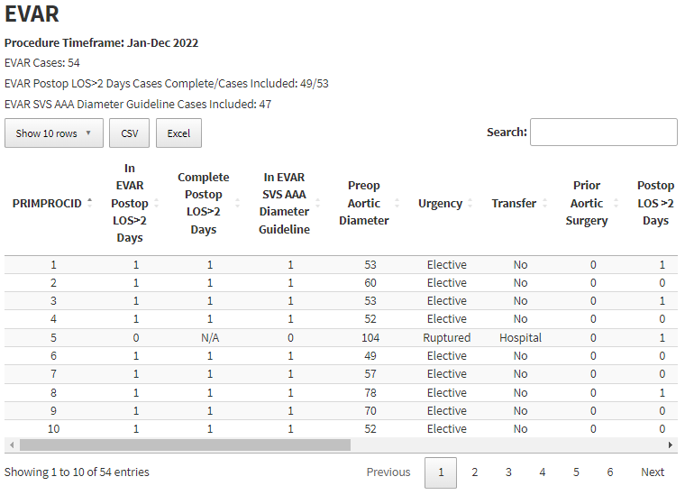
Drill-Down
Binary indicator for report inclusion
(1 = yes, 0 = no)
Binary report outcome (1 = yes, 0 = no)
Notes:
For non-risk-adjusted reports, there are also binary indicators for report inclusion. [click]
Here we can see the binary indicator for the EVAR SVS AAA Diameter Guideline report. Now, the drill-down tables contain all data elements that are used to construct the reports, so centers can use these tables to determine why specific cases were included or excluded from a report. More importantly, centers can use the drill-down tables to determine which cases had certain events of interest. [click]
For example, we can see this case was excluded from both the EVAR: Postop LOS>2 Days and EVAR: SVS AAA Diameter Guideline reports because the procedure was performed on a ruptured aneurysm. [click]
And you can use the binary report outcomes to quickly determine which cases had a postop LOS greater than 2 days. Here we can see 3 elective cases where the postop LOS was greater than 2 days. [click]

Slide 19
Drill-Down
Returns every row containing at least 1 cell satisfying the value entered in the search bar
Sort on any column by clicking the double arrows
Use scroll bar to see additional variables
Notes:
Note the columns shown here are not the only columns in the drill-down table, so you can use the scroll bar to see additional columns. You can also sort on any column by clicking the double arrows as shown here. [click]
The search function can be helpful when looking for a specific PRIMPROCID. It returns every row containing at least 1 cell satisfying the value entered in the search bar. [click]

Slide 20
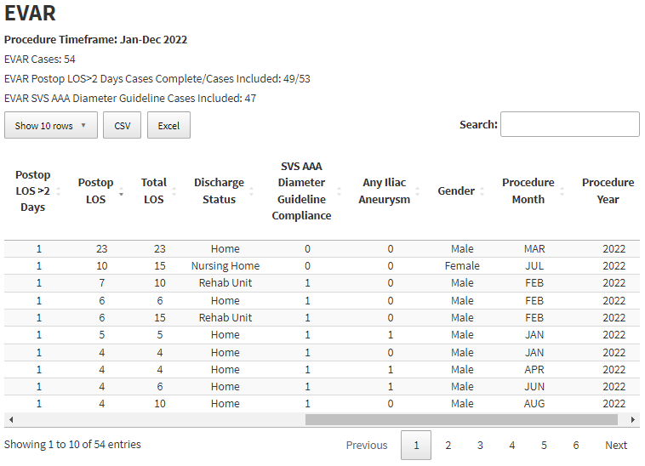
Drill-Down
Notes:
Even these simple features can be useful. Here I’ve used the scroll bar to scroll over and look at some of the other columns given in the table. I’ve sorted on Postop LOS to identify cases that had the longest postop LOS. [click]
Now, some drill-down tables contain many variables. For example, the CEA drill-down table contains more than 50 columns. For such tables, downloading them and manipulating the data in excel is strongly recommended. [click]

Slide 21
Drill-Down
Notes:
For reports involving multiple procedure registries, like the 4 shown here, separate drill-down tables are included. [click]

Slide 22
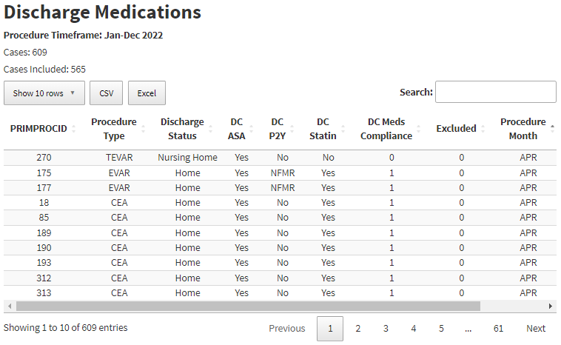
Drill-Down
Exclusion indicator
(1 = excluded, 0 = not excluded)
Binary report outcome (1 = yes, 0 = no)
Notes:
For example, we see here the Discharge Medications drill-down table. [click]
Note there is a column giving the procedure type for each case. [click]
And of course, the binary report outcome of DC Meds Compliance is given, as well as an exclusion indicator. For this indicator, 1 = excluded and 0 = not excluded. [click]

Slide 23
Interpretation
High-level summary of results
Notes:
And finally, we’ll conclude this talk with a few notes on interpreting the reports and how you can look for areas where your center is doing well or possible areas for improvement. [click]
The dashboard report, which contains a high-level summary of results for all reports, is a good starting point in this exercise. [click]

Slide 24
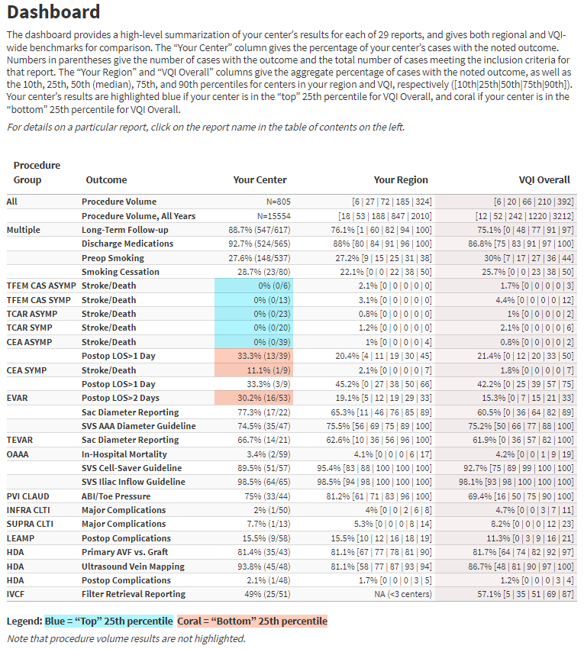
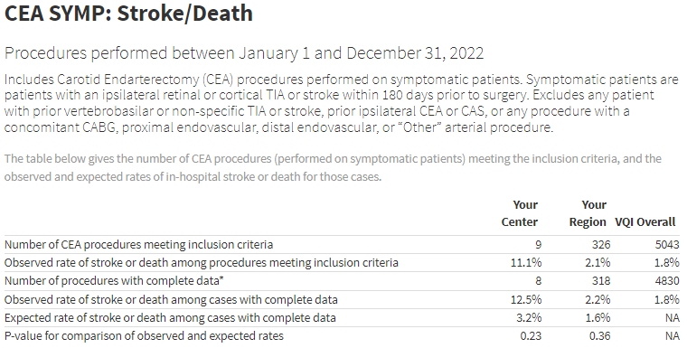
Interpretation
Notes:
The first thing to note is that for risk-adjusted reports, the dashboard gives the observed rate among procedures meeting inclusion criteria. [click]
For example, we see here that the values given in the dashboard match the corresponding values given in the comparison table. [click]
Now, if this report looks familiar to you, it should! This report has the same structure and follows the same rules as the quarterly VQI Best Practices Dashboard to identify centers that are in the top 25th percentile or bottom 25th percentile of a distribution. [click]

Slide 25
Interpretation
Explore reports where your center is in the top 25th percentile or bottom 25th percentile
Notes:
So, one way you can look for areas where your center is doing well, or possible areas for improvement, is to explore reports where your center is in the top 25th percentile or bottom 25th percentile of the distribution. [click]

Slide 26
Interpretation
Color highlights emphasize a center’s location at the “extreme” ends of the overall VQI distribution
Must proceed with caution when interpreting results
  Coral doesn’t necessarily mean “bad”
  Blue doesn’t necessarily mean “good”
https://www.vqi.org/resources/reporting
Notes:
But like we discussed in last year’s presentation on the quarterly VQI Best Practices Dashboard, centers must proceed with caution when interpreting dashboard results. This slide is from our presentation last year, where it was made clear that coral (bottom 25th percentile) doesn’t necessarily mean “bad”, and blue (top 25th percentile) doesn’t necessarily mean “good”. [click]
For the sake of brevity, we’ll reference last year’s presentation for details, which again is available on the VQI Reporting website as shown here. Slides 34-45 focus exclusively on this topic. [click]

Slide 27
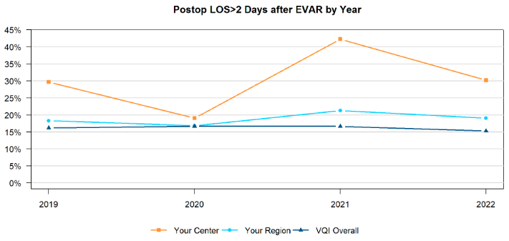
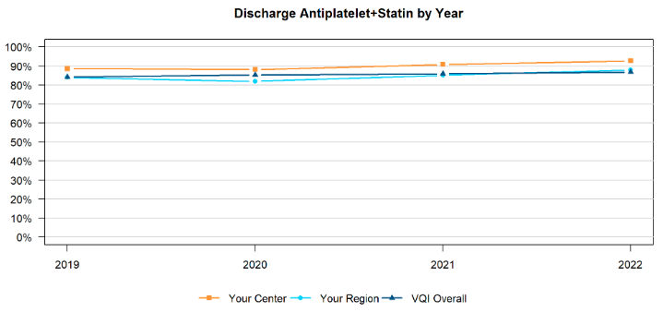
Interpretation
Explore reports where your center is in the top 25th percentile or bottom 25th percentile
Explore reports where your center’s results are statistically significant
  Is your center’s rate significantly different than your region’s rate?
  Is your center’s observed rate significantly different than your center’s expected rate?
Explore long-term visual trends
  No p-values or percentiles necessary!
YES
Notes:
Another way you can look for areas where your center is doing well, or possible areas for improvement, is to, of course, explore reports where your center’s results are statistically significant. [click]
If the answer to either of these questions is YES, this represents an opportunity for quality improvement and warrants further investigation to determine whether these differences are clinically meaningful. [click]
And lastly, you can always explore long-term visual trends – no p-values or percentiles necessary! [click]
For example, this center has had persistently high rates of postop LOS>2 days after EVAR for 4 consecutive years, which may represent an opportunity for quality improvement regardless of p-values or percentiles. [click]
Similarly, this center has had persistently high rates of discharge medication rates for 4 consecutive years. And regardless of p-values or percentiles, these results may represent an important opportunity to celebrate success for the center. Thank you very much for your time and attention. [click]

