Slide 1
PSO Reporting
VQI Best Practices Dashboard
Drilling Into Quarterly Dashboards
June 2022
Notes:
This presentation focuses on the VQI Best Practices Dashboard – the information contained in these reports, how to drill-down and interpret your data, and how you can use these reports to facilitate and drive quality improvement at your institution.
Users are encouraged to view this presentation in “Slide Show” mode for maximum benefit, as some slides contain layers of animation that may appear cluttered or overwhelming when viewed as a single slide with static content.
Narrative text is provided in the “Notes” section of each slide to further explain and clarify content, as necessary.

Slide 2
Overview
Motivation
Why are we talking about these reports?
What is included (and excluded)?
Structure
Measures
Tracking Your Cases
Inclusion/Exclusion Criteria
Drill-Down
Interpretation
Notes:
Overview

Slide 3
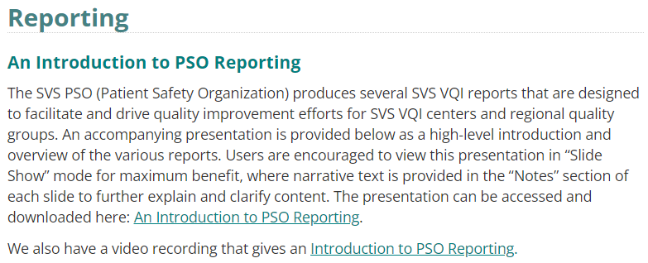
Motivation
An Introduction to PSO Reporting (vqi.org/resources/reporting)
Notes:
An Introduction to PSO Reporting presentation already exists that focuses on providing a high-level overview and introduction to all PSO reports. For this presentation, we wanted to focus on really drilling into a single VQI report.

Slide 4
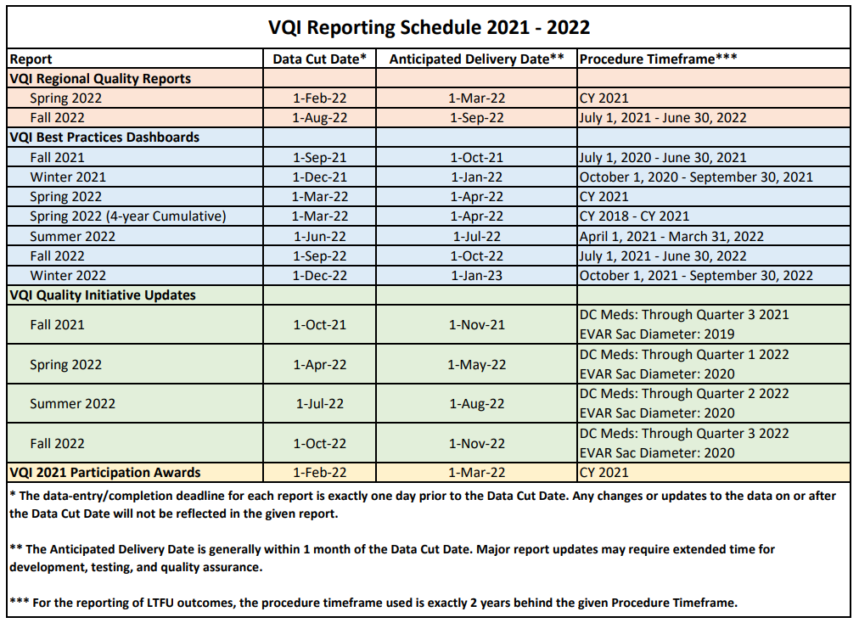
Motivation
VQI Reporting Schedule (vqi.org/resources/reporting)
VQI Best Practices Dashboard
VQI Quality Initiative Update
VQI Regional Quality Report
VQI Participation Awards
5 per year
3 per year
2 per year
1 per year
Notes:
As given on the VQI Reporting Schedule, the VQI produces 4 distinct reports.
The VQI Best Practices Dashboard is the most frequently produced report, with 5 reports per year.

Slide 5
Motivation
Quarterly (4 per year)
1-year procedure timeframe window
Incremented by 3 months every report
Cumulative (1 per year)
4-year procedure timeframe window
Incremented by 1 year every report
Notes:
The highlighted report here is the 4-year cumulative dashboard, whereas the other 4 listed reports are quarterly dashboards distributed in the Spring, Summer, Fall, and Winter. The quarterly dashboards and cumulative dashboards are identical and differ only with respect to the procedure timeframe for analysis.
The quarterly reports have a 1-year procedure timeframe that is updated every 3 months with each report. You can think of this as a moving 1-year window that shifts 3 months with every report.
The cumulative report has a 4-year procedure timeframe that is updated every year with each report, so you can similarly think of this as a moving 4-year window that shifts 1 year with every report.

Slide 6
Motivation
Lack of Awareness
VQI Regional Quality Report
Cornerstone of VQI regional quality group meetings
23 key, targeted measures
VQI Best Practices Dashboard
Wealth of information
Over 200 measures
Notes:
While the regional reports remain an important emphasis for the VQI’s quality mission, the dashboards also represent a wealth of information that can be used in tandem or entirely separate from the regional reports to aid in your center’s quality improvement efforts.

Slide 7
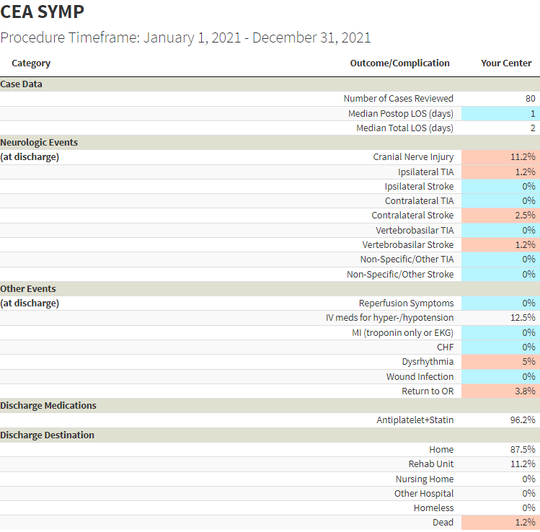
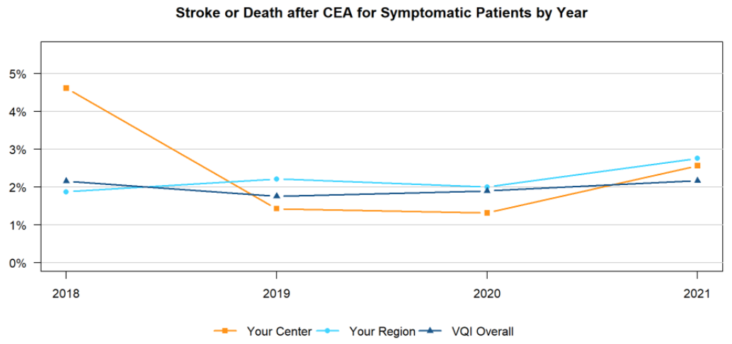
Motivation
VQI Regional Quality Report
VQI Best Practices Dashboard
Notes:
Indeed, many of the measures provided in the regional reports are reflected in the dashboards. Take for example the CEA SYMP: Stroke/Death measure from the regional report.
The stroke/death measure in the regional report is an aggregated measure consisting of any periprocedural stroke or death.
The dashboards also provide this information, but on a more granular level by listing the individual stroke and death outcomes.

Slide 8
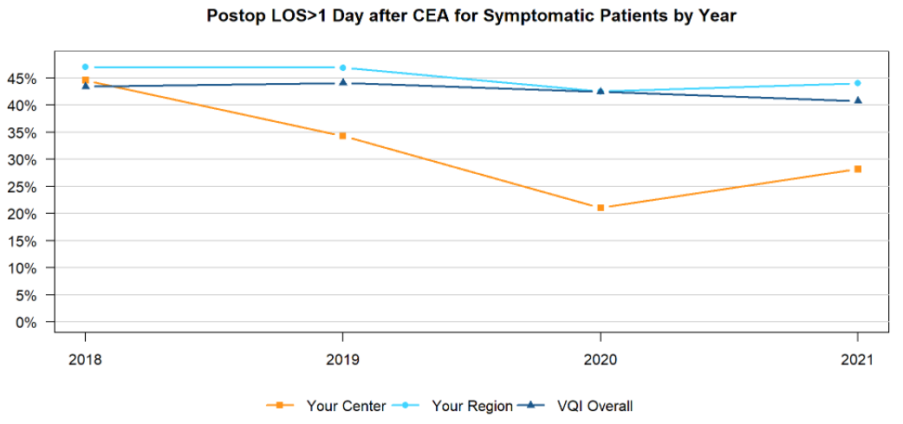
Motivation
VQI Regional Quality Report
VQI Best Practices Dashboard
Notes:
Similarly, we see that postop length-of-stay is measured in both the regional reports and the dashboard reports, though again in slightly different ways.

Slide 9
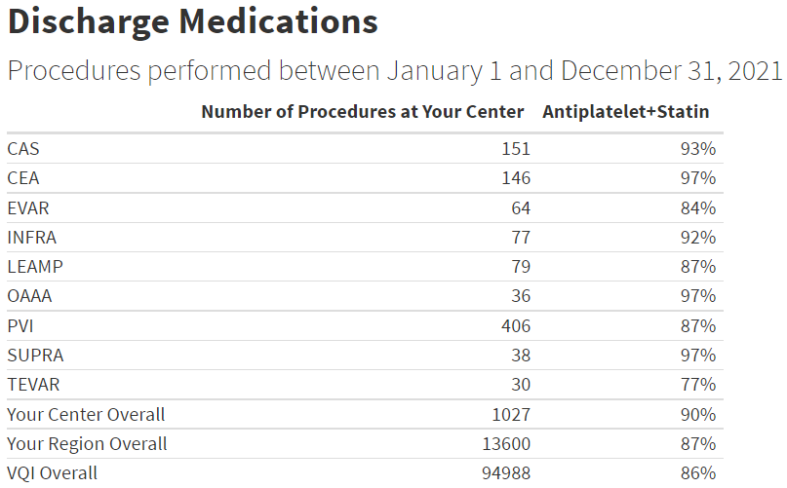
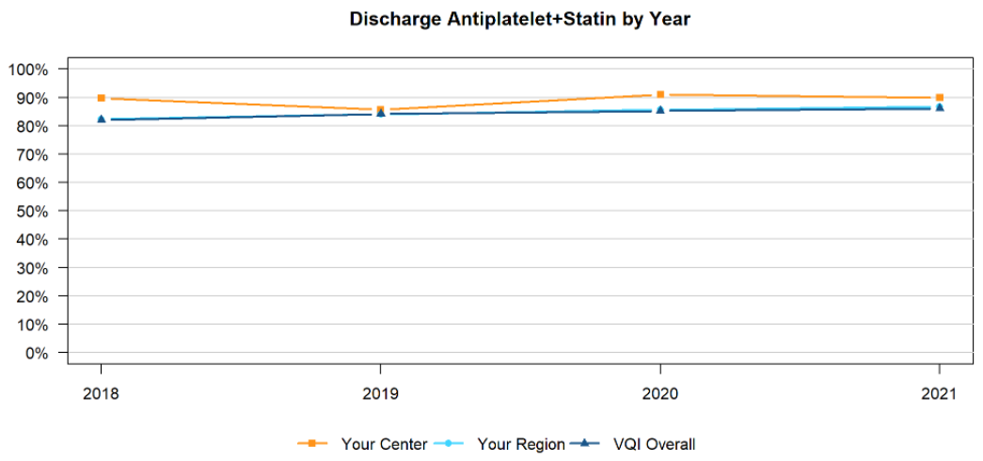
Motivation
VQI Regional Quality Report
VQI Best Practices Dashboard
Notes:
As another example, we see that Discharge Medications are also common to both the regional report and the dashboard report.

Slide 10
Motivation
VQI Regional Quality Report
VQI Best Practices Dashboard
Notes:
There are, however, many measures in the dashboards that are not in the regional reports. For example, the measures highlighted here have no counterparts in the regional reports, making the dashboards an additional, stand-alone resource for quality improvement.

Slide 11
Overview
Motivation
Why are we talking about these reports?
What is included (and excluded)?
Structure
Measures
Tracking Your Cases
Inclusion/Exclusion Criteria
Drill-Down
Interpretation
Notes:
What is included (and excluded) in the dashboards?

Slide 12
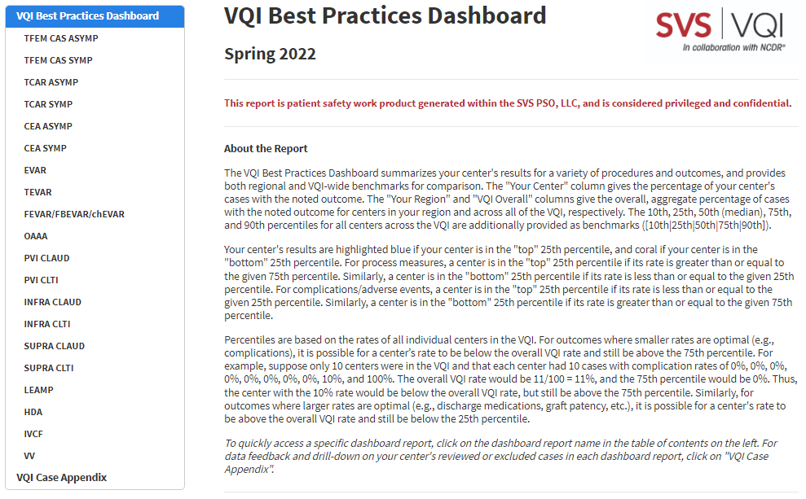
Structure
20 dashboard reports
based on 12 procedure registries
For registries with multiple reports, cases are stratified into mutually exclusive cohorts
Notes:
Each dashboard is an interactive report designed to be opened and manipulated in a web browser. When you open the report, a table of contents appears on the left, as pictured here for the Spring 2022 quarterly dashboard. The table of contents can be used to navigate to each individual report.
There are a total of 20 dashboard reports based on 12 VQI procedure registries.
Some registries have only 1 report. For example, EVAR.
Some registries have multiple reports. For example, PVI cases are split into separate dashboards for claudication and CLTI.
Similarly, CAS cases are stratified by asymptomatic/symptomatic and TFEM CAS/TCAR for a total of 4 reports associated with the CAS registry.
For registries with multiple reports, cases are stratified into mutually exclusive cohorts.

Slide 13
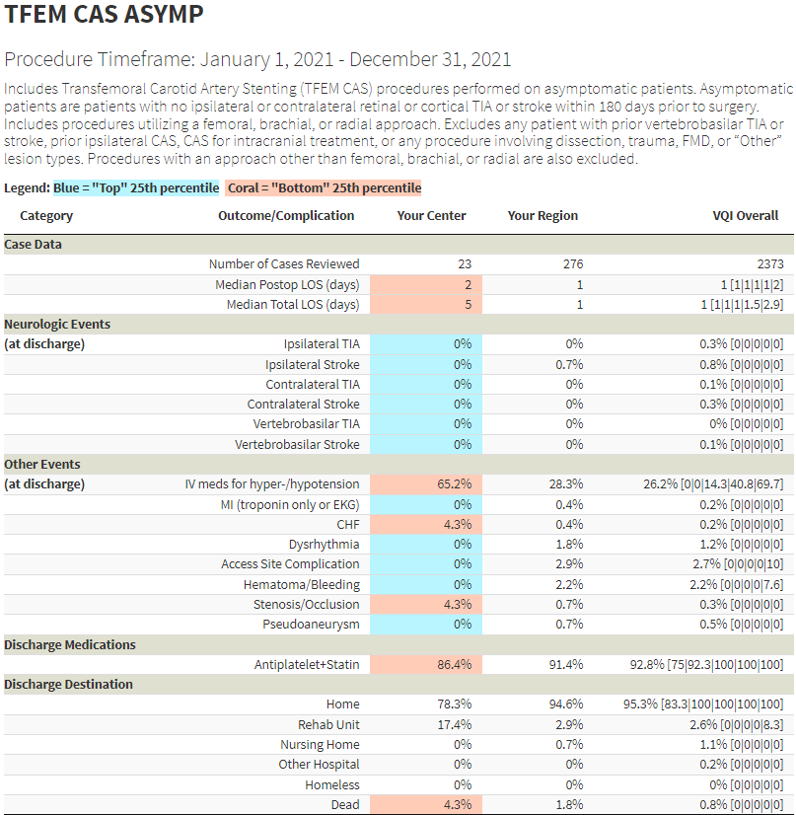
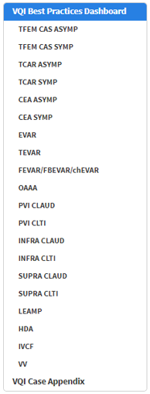
Measures
Reports from the same registry have identical measures
Reports from different registries may have different measures
Registry-specific measures
Harmonization where appropriate
Notes:
Reports from the same registry have identical measures. For example, the measures listed here in the TFEM CAS ASYMP report are the exact same measures that will appear in the other 3 reports from the CAS registry.
Reports from different registries may of course have different, registry-specific measures, though there is some level of harmonization where appropriate. For example, all carotid dashboards have similar measures, EVAR/TEVAR/OAAA dashboards have similar measures, and lower extremity (PVI, INFRA, SUPRA) dashboards have similar measures.

Slide 14
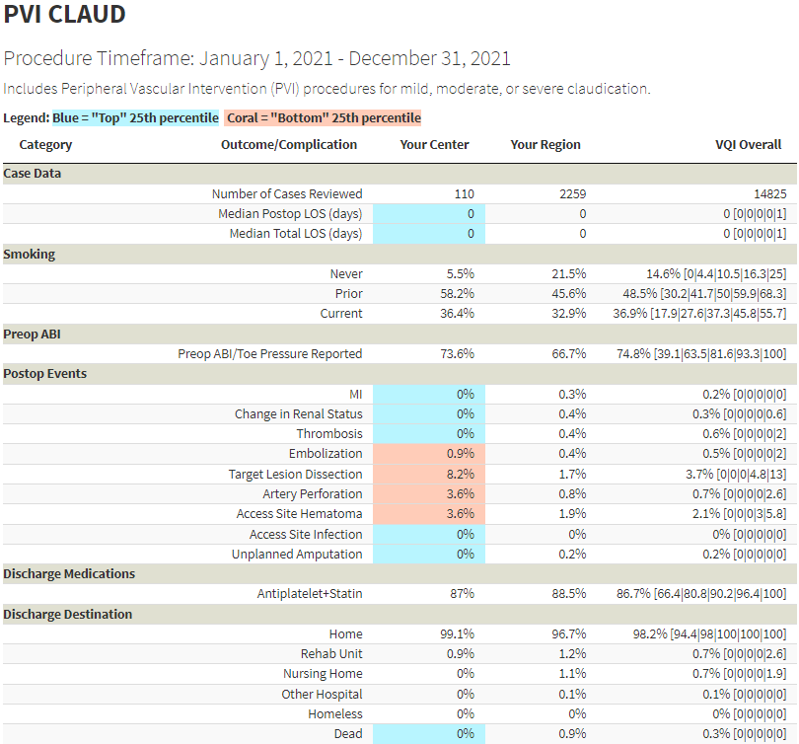
Measures
Notes:
With respect to measures, the PVI claudication dashboard shown here provides a nice representation of the variety of measures one might see in a dashboard report.
As seen previously, length-of stay and discharge information are reported, as well as a variety of postoperative events.
In addition, preoperative measures like smoking and ABI/Toe Pressure Reporting are also included.

Slide 15
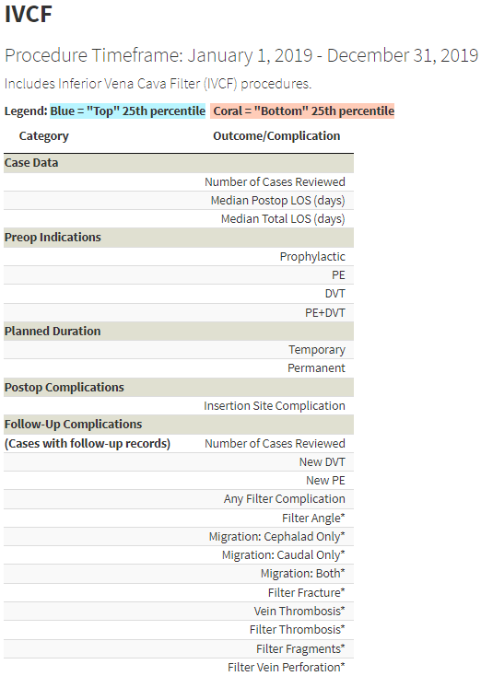
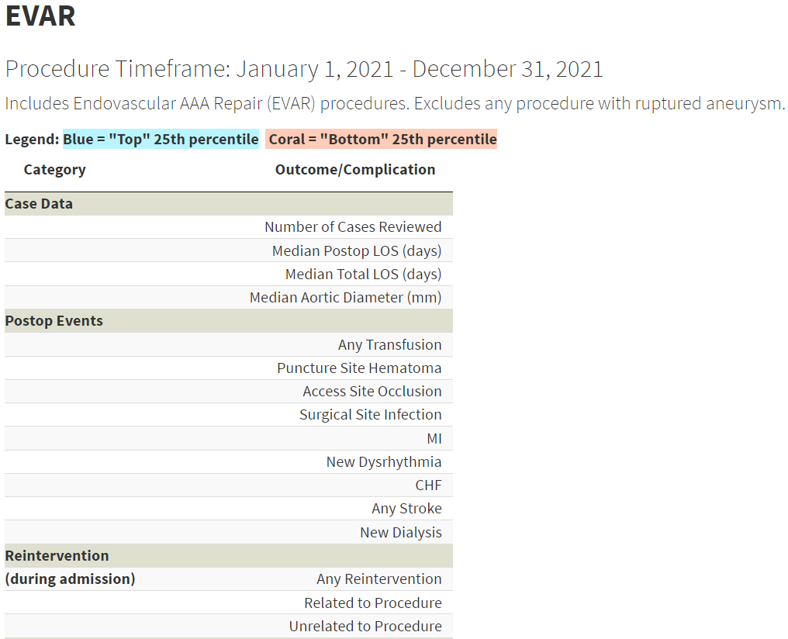
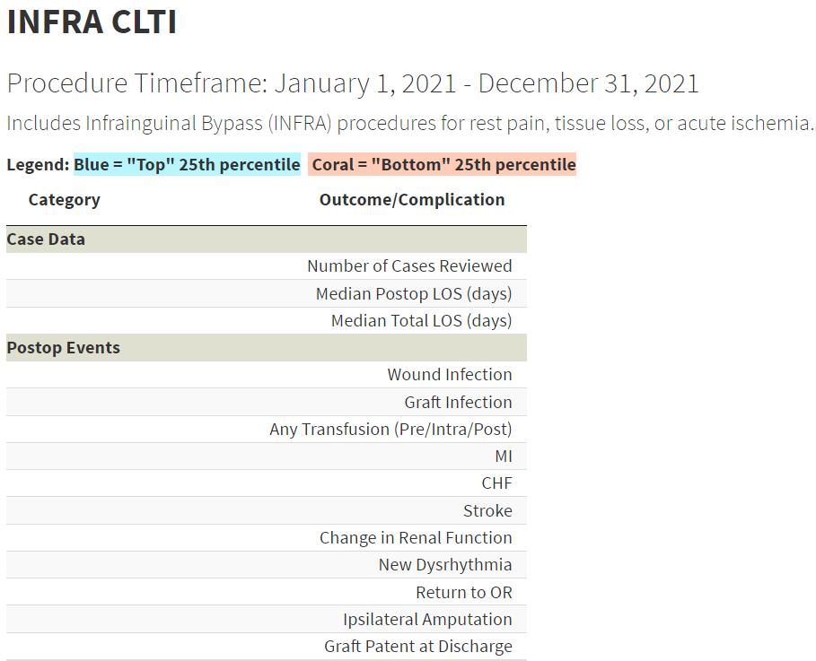
Measures
Notes:
And here are screenshots from various dashboards to further highlight and demonstrate the variety of measures reported.

Slide 16
Measures
Over 200 measures
A wealth of information
Procedure Characteristics
Preoperative Measures
LOS (postoperative and total)
Discharge Status
Process Measures
Complications
Preoperative or perioperative measures
No long-term outcomes (IVCF is the exception)
Notes:
The dashboards contain over 200 measures that represent a wealth of information for VQI centers.
And since the dashboards focus on preoperative and perioperative (from surgery to discharge) measures, no long-term outcomes are included, though the IVCF dashboard is a notable exception that also provides long-term outcomes.

Slide 17
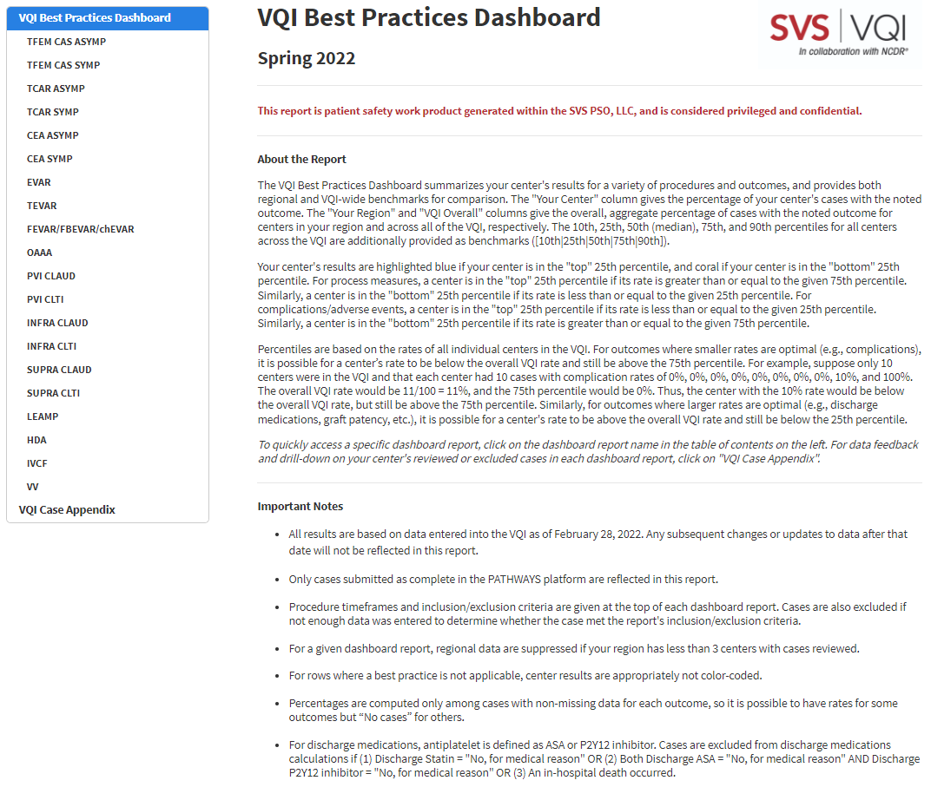
Tracking Your Cases
Notes:
Centers often have questions about why certain cases were or were not included in the reports, so we’ll focus on reasons why the number of cases in the dashboard reports may not match what you expect, as outlined in the “Important Notes” section of the report.

Slide 18
Tracking Your Cases
Reasons Why the Number of Cases in the Reports May Not Match What You Expect
(1)
Notes:
The first reason is that all report results are based on data entered into the VQI as of a certain date. Any subsequent changes or updates to data after that date will not be reflected in the report.

Slide 19
Tracking Your Cases
At least 2 months for data collection/abstraction
Not included in Spring 2022 Dashboard
Case performed in December 2021
Submitted in March 2022
Notes:
Going back to the VQI reporting schedule, we see the Data Cut Date for the Spring 2022 report was March 1, 2022, so the report reflects data entered into the VQI one day prior on February 28, 2022.
Now, suppose your center has a case that was performed in December of 2021, during the report’s procedure timeframe.
If that case was submitted in say March of 2022, then that case would not be included in the datasets used to generate the report and therefore would not be included in the Spring 2022 dashboard.
In general, it is important to pay attention to Data Cut Dates and Procedure Timeframes given in the VQI reporting schedule to ensure all your center’s cases in the procedure timeframe are abstracted and submitted prior to the Data Cut Date.
And as we see here, all dashboards provide at least 2 months for data abstraction and submission.

Slide 20
Tracking Your Cases
Reasons Why the Number of Cases in the Reports May Not Match What You Expect
(1)
(2)
Notes:
The second reason why the number of cases in the reports may not match what you expect is that only cases submitted as complete (or cases submitted without validation) in the PATHWAYS platform are reflected in the reports.

Slide 21
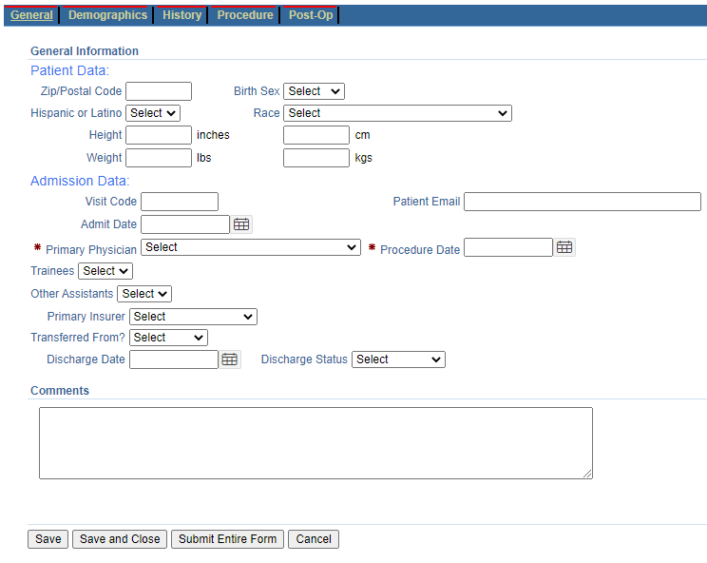
Tracking Your Cases
Notes:
The first screenshot is from our PATHWAYS demo environment showing two procedures, where you see one procedure was submitted as complete, and the other was submitted as incomplete. Incomplete procedures are not included in the datasets we use to generate reports, so such procedures will not be reflected in the reports. A complete procedure has all the required information on the procedure form filled in, whereas an incomplete procedure does not.
The second screenshot shows a procedure form with no information filled in. If we go to submit the form a pop-up window appears (the third screenshot), notifying us of the missing, required information necessary for the form to be submitted as complete and for the procedure to ultimately be reflected in the reports.

Slide 22
Tracking Your Cases
Reasons Why the Number of Cases in the Reports May Not Match What You Expect
(1)
(2)
(3)
Notes:
And finally, the third reason is that the case or cases you’re looking at may not have been performed during the report’s procedure timeframe.

Slide 23
Tracking Your Cases
Not included in Spring 2022 Dashboard
Case performed in January 2022
Abstracted in February 2022
Notes:
Going back to the reporting schedule, we see the procedure timeframe for the Spring 2022 dashboard was calendar year 2021.
So, if a case was performed in January of 2022 and abstracted in February of 2022, then even though the case was submitted prior to the Data Cut Date, the case would not be included in the Spring 2022 dashboard because it was not performed during the report’s procedure timeline.

Slide 24
Tracking Your Cases
In order to appear in a dashboard, cases must be…
Submitted prior to the report data cut date AND
Submitted as complete AND
Performed in the report procedure timeframe
Necessary, but not sufficient conditions. Still possible for a case to be excluded from the dashboards due to…
Inclusion/Exclusion criteria
Not enough data was entered to determine whether the case met the report’s inclusion/exclusion criteria
True for every VQI report, not just dashboards
Notes:
So in order to appear in a dashboard report, cases must meet all 3 of these conditions.
And this is true for every VQI report, so keeping track of the VQI reporting schedule to ensure all your center’s cases are submitted as complete prior to the data cut date is important.
Note these are necessary, but not sufficient conditions for inclusion – it is still possible for a case to be excluded from the dashboards even if all 3 conditions are met.
This could happen due to the report’s inclusion/exclusion criteria, or if not enough data was entered to determine whether the case met the report’s inclusion/exclusion criteria.

Slide 25
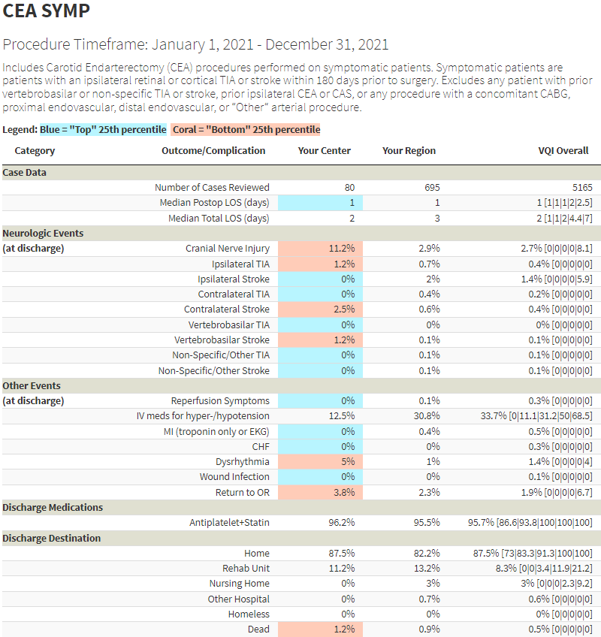
Inclusion/Exclusion Criteria
Notes:
This brings us to the very important topics of inclusion/exclusion criteria and drill-down.
The first thing to note is that inclusion/exclusion criteria for each dashboard report are given at the top of each report, directly below the procedure timeframe, as shown here in blue for CEA SYMP and PVI CLAUD.
We see this center had 80 cases included in the CEA SYMP dashboard and 110 cases included in the PVI CLAUD dashboard.
At some point, you’re going to be interested in identifying cases that were included or excluded from a report. And more importantly, you’re going to be interested in identifying cases that had complications, cases with extended length-of-stay, or cases not receiving discharge medications, etc.
To answer these questions, embedded drill-down functionality is included in the form of the VQI Case Appendix.

Slide 26
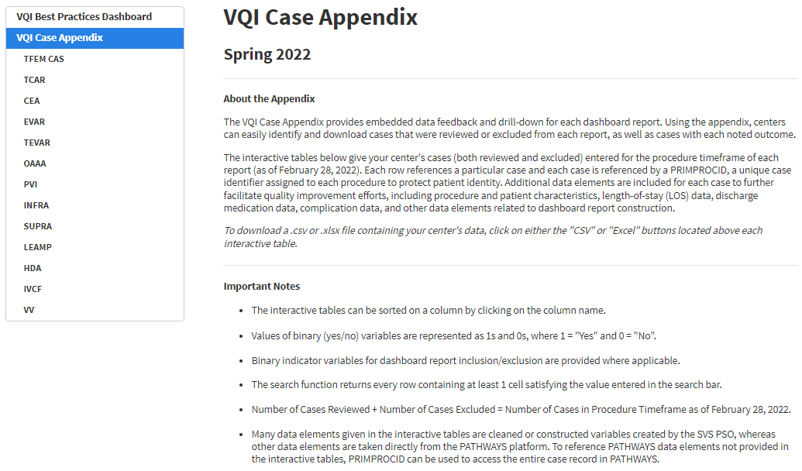
Drill-Down
13 interactive drill-down tables associated with 12 procedure registries
Identify which cases were included/excluded in each report
Identify why cases were included/excluded in each report
Identify cases with outcomes of interest
Notes:
If you click on “VQI Case Appendix” in the table of contents, you’ll be directed to the VQI Case Appendix, as shown here.
The case appendix consists of 13 interactive drill-down tables associated with 12 VQI procedure registries. There is 1 drill-down table per registry, with CAS being the only exception.
The case appendix has 3 primary functions, as shown in this slide.
Let’s now look at one of these drill-down tables, for example INFRA, to get a better idea of the functionality provided.

Slide 27
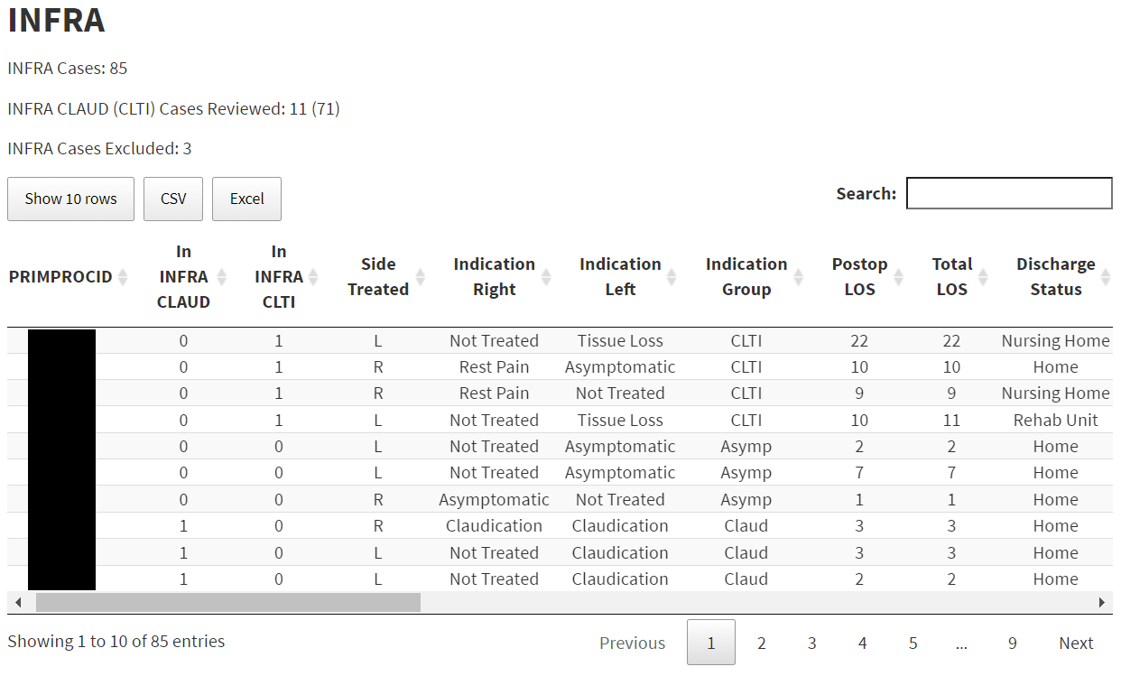
Drill-Down
Total # of cases in the procedure timeframe submitted as complete prior to the data cut date
# of cases included in each report
Change the # of rows for display
# of cases not included in either report (note: 3+11+71=85)
Binary indicators for report inclusion
(1=yes, 0 = no)
Download the table as .csv or .xlsx file
Click to page thru your cases
Notes:
Here we see the INFRA drill-down table.
First, note the total number of cases in the procedure timeframe given at the top, and how this matches the number of entries (rows) in the table.
Every row in the table represents a case, and cases are indexed by PRIMPROCID, a unique case identifier assigned to each procedure to protect patient identity.
The default display is 10 rows per case, but you can change the number of rows displayed with this button.
You can also click these buttons to page thru your cases.
These buttons allow you to download either a .csv or .xlsx file containing all the data in the interactive table.
The number of cases included in each dashboard is given, as well as the number of cases not included in either dashboard.
You can tell what specific cases were included or excluded in each dashboard using the binary indicators shown here.
These cases were included in the INFRA CLTI dashboard (In INFRA CLTI = 1).
These cases were included in the INFRA CLAUD dashboard (In INFRA CLAUD = 1).
These cases were not included in either dashboard (In INFRA CLTI = 0 and In INFRA CLAUD = 0).
At this point, we recall the inclusion/exclusion criteria for the reports and reference the note in the lower left-hand corner which states that indication group is based on the recorded indication for the side treated. And with this in mind, we can quickly see why cases were assigned or not assigned to each dashboard.
This first case had left-side treatment with a left-side indication of tissue loss and was therefore included in the INFRA CLTI dashboard.
This case had right-side treatment with a right-side indication of claudication and was therefore included in the INFRA CLAUD dashboard.
And finally, this case had left-side treatment with a left-side indication of asymptomatic. Since the treatment was not performed for claudication, rest pain, tissue loss, or acute ischemia, it is excluded from both dashboards.

Slide 28
Drill-Down
Returns every row containing at least 1 cell satisfying the value entered in the search bar
Sort on any column by clicking the double arrows
Use scroll bar to see additional variables
Notes:
Note the columns shown here are not the only columns in the interactive table, so you can use the scroll bar to see additional columns in the table. You can also sort on any column by clicking the double arrows shown here.
The search function can be helpful when looking for a specific PRIMPROCID. It returns every row containing at least 1 cell satisfying the value entered in the search bar.

Slide 29
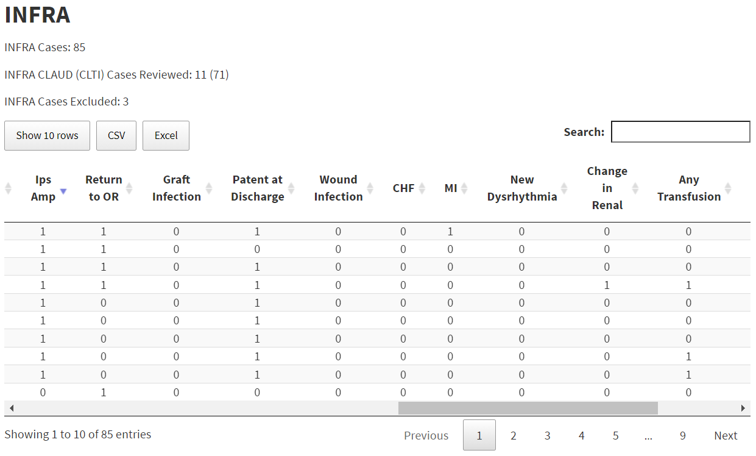
Drill-Down
Notes:
Even these simple features can be quite useful. Here the scroll bar has been used to scroll over and look at some of the outcomes given in the table. The table has been sorted on Ips Amp (Ipsilateral Amputation) to quickly identify the 9 cases that had this event.
We see 1 of these cases also had a postop MI, and 2 of these cases were not patent at discharge.
Some drill-down tables contain many variables. For example, the CEA drill-down table contains 52 columns. For such tables, downloading and manipulating the data in excel is strongly recommended.

Slide 30
Drill-Down
Not enough data entered
Met Exclusion Criterion
Notes:
Here we see the inclusion/exclusion criteria for the CEA dashboards.
Cases are assigned to the CEA dashboards based on patients’ symptomatic or asymptomatic status, defined as symptomatic if the patient had an ipsilateral retinal or cortical TIA or stroke within 180 days prior to surgery, and asymptomatic otherwise.
You see here the CEA drill-down table downloaded as an excel file. There are of course not 52 columns in this screenshot, as many columns in the excel file have been deleted to only focus on a select few.
The first thing to note is there are again binary indicators for report inclusion. Cases in blue were included in the asymptomatic dashboard, cases in yellow were included in the symptomatic dashboard, and cases in green were excluded from both dashboards.
For the first case, we see the patient did not have any prior TIA or stroke, so the patient was asymptomatic, and the case was included in the ASYMP dashboard.
For the second case, we see the patient had an ipsilateral cortical stroke, but it occurred 511 days prior to the procedure, so the patient was asymptomatic, and the case was included in the ASYMP dashboard.
The third case had an ipsilateral retinal TIA 22 days prior to the procedure, so the patient was symptomatic, and the case was included in the SYMP dashboard.
The fourth case had an ipsilateral cortical stroke 5 days prior to the procedure, so the patient was symptomatic, and the case was included in the SYMP dashboard.
For the next two cases, note the SYMP/ASYMP column is blank. This means not enough information was entered to determine symptomatic or asymptomatic status. For the first case where SYMP/ASYMP is blank, no prior TIA or stroke data was entered, so we can’t determine symptomatic/asymptomatic status, and the case is excluded from both dashboards. For the second case where SYMP/ASYMP is blank, a prior ipsilateral TIA was noted, but the date of the TIA was not recorded, so we don’t know whether the TIA occurred within 180 days prior to the procedure. Given this, we again can’t determine symptomatic/asymptomatic status and the case is excluded from both dashboards.
For the last two cases (rows 8 and 9), we see both had enough data to determine symptomatic/asymptomatic status. However, each of these cases met an exclusion criterion, with one excluded due to the procedure being performed with a concomitant distal endovascular procedure (such as Angioplasty or Stent of Distal Internal Carotid Artery, and/or Bifurcation) and the other excluded due to the procedure being performed with a concomitant CABG.
From this example we see 2 procedures were excluded because not enough data was entered, and 2 procedures were excluded due to inclusion/exclusion criteria.

Slide 31
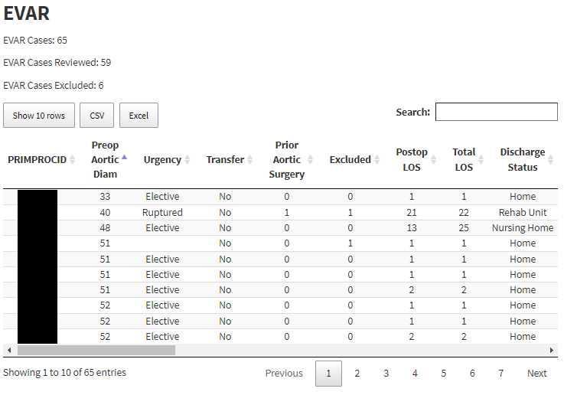
Drill-Down
Notes:
Before we move on to the next topic, note that for registries with only 1 dashboard, there is only 1 binary indicator for report inclusion/exclusion, as shown here in the EVAR drill-down table. For these indicators, 1 = excluded and 0 = no, not excluded.
Because ruptured aneurysms are excluded from the EVAR dashboard, we see two of these cases were excluded. Note one case was excluded because a ruptured aneurysm was noted, whereas the other was excluded because this information was missing, and we can’t determine whether the aneurysm was ruptured.

Slide 32
Overview
Motivation
Why are we talking about these reports?
What is included (and excluded)?
Structure
Measures
Tracking Your Cases
Inclusion/Exclusion Criteria
Interpretation
Notes:
Now that we’re familiar with what’s included in the dashboards, we’ll shift gears one last time and talk about interpreting the reports.

Slide 33
Interpretation
Notes:
Much of what we will be discussing is mentioned in the “About the Report” and “Important Notes” sections of the dashboards, so centers are strongly encouraged to read and review this information when interpreting the reports.

Slide 34
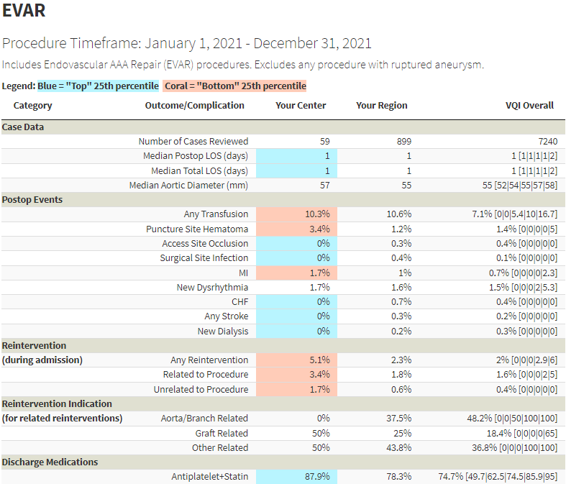
Interpretation
2/59 = 3.4%
2/49 = 4.1%
How do center rates vary across the VQI?
Percentiles
[10th|25th|50th|75th|90th]
Notes:
We’ve seen several dashboards up to this point, but we haven’t really talked about the dashboard content itself and what the columns in the dashboard represent.
The first column gives your center’s rate for a given measure, or in the case of numeric measures – your center’s median value.
We see here that 2 of this center’s 59 procedures resulted in a puncture site hematoma, for a rate of 3.4%.
Cases with missing data for an outcome are excluded from percentage calculations. So for example, if 10 of this center’s 59 cases were missing data for the puncture site hematoma measure, then the calculated rate would instead be 2/49 = 4.1%.
Further, we see the median aortic diameter among these procedures was 57 millimeters.
And the center’s discharge medications rate was 87.9%
The second column gives the region’s rate, and the third column gives the overall VQI rate. We see that across the entire VQI, the aggregate discharge medications rate for EVAR was 74.7%.
So, the overall VQI rate is 74.7%, but a natural question to ask is: How do individual center rates vary across the VQI? For example, does every EVAR center in the VQI have a discharge medication rate of 74.7%? Probably not of course, but what does the distribution of center rates look like? For example, do most centers tend to have higher rates or lower rates?
To answer such questions and inform centers of where they stand in the overall VQI distribution, the dashboards provide percentiles, which are based on the rates of all individual VQI centers contributing data to the report. As we see here, the 10th, 25th, 50th, 75th, and 90th percentiles are provided for each measure.

Slide 35
Interpretation
90% of all EVAR centers had a rate ≤ 94.9%
75% of all EVAR centers had a rate ≤ 85.8%
25% of all EVAR centers had a rate ≤ 62.5%
10% of all EVAR centers had a rate ≤ 49.7%
[49.7|62.5|75|85.8|94.9]
[10th|25th|50th|75th|90th]
Median
50% of all EVAR centers had a rate ≤ 75%
50% of all EVAR centers had a rate > 75%
Notes:
Looking at the discharge medications measure, we see the 10th percentile was 49.7%, so this means 10% of all EVAR centers had a discharge medications rate less than or equal to 49.7%.
The 25th percentile was 62.5%, so 25% of all EVAR centers had a discharge medications rate less than or equal to 62.5%.
The 50th percentile, also known as the median, was 75%, so 50% of all EVAR centers had a discharge medications rate less than or equal to 75%. Which of course means that 50% of all EVAR centers had a discharge medications rate greater than 75%.
The 75th percentile was 85.8%, so 75% of all EVAR centers had a discharge medications rate less than or equal to 85.8%.
And finally, the 90th percentile was 94.9%, so 90% of all EVAR centers had a discharge medications rate less than or equal to 94.9%.
The 25th, 50th, and 75th percentiles partition centers into 4 groups, where each group has the same number of centers.

Slide 36
Interpretation
Process Measure
25% of centers
25% of centers
25% of centers
25% of centers
1st Quartile
2nd Quartile
3rd Quartile
4th Quartile
0
62.5
75
85.8
100
25th 50th 75th
“Bottom” 25th percentile
“Top” 25th percentile
Center results highlighted coral
Center results highlighted blue
Notes:
For a visual, consider the number line here. Every center is going to have a discharge medications rate between 0% and 100%, and we can see the 25th, 50th, and 75th percentiles represented.
These percentiles partition centers into 4 groups, where each group has the same number of centers. This means 25% of the total number of EVAR centers are in each group, so if 300 centers contributed data to the report, there would be 75 centers in each group. These groups are also referred to as quartiles, so you see them labeled here as the first, second, third, and fourth quartiles.
Since this is a process measure, larger rates are optimal, and we refer to the 4th quartile as the so-called “top” 25th percentile. Centers in the top 25th percentile will have their results highlighted blue.
Similarly, we refer to the 1st quartile as the so-called “bottom” 25th percentile , and centers in the bottom 25th percentile will have their results highlighted in coral.
As we see here, this center’s rate was greater than the 75th percentile, so it was in the top 25th percentile and highlighted blue.

Slide 37
Interpretation
Adverse Event/Complication
25% of centers
25% of centers
25% of centers
25% of centers
1st Quartile
2nd Quartile
3rd Quartile
4th Quartile
0
3.1
8.3
16.7
100
25th 50th 75th
“Top” 25th percentile
“Bottom” 25th percentile
Center results highlighted blue
Center results highlighted coral
Notes:
Let’s now consider what the picture looks like for an adverse event or complication. Here we see the Lower Extremity Amputation Postop Complication measure. As before, every center is going to have a complication rate between 0% and 100%, and we can again represent the 25th, 50th, and 75th percentiles on the number line.
And again, we can form the same partition as before.
But this time, we’re looking at a complication, where smaller rates are optimal, so we now refer to the first quartile as the “top” 25th percentile.
Similarly, the 4th quartile now represents the “bottom” 25th percentile.
As we see here, this center’s rate was greater than or equal to the 75th percentile, so it was in the bottom 25th percentile and highlighted coral.

Slide 38
Interpretation
Process Measures
Center Rate ≥ 75th Percentile ----> “Top” 25th percentile
Center Rate ≤ 25th Percentile ----> “Bottom” 25th percentile
Adverse Events/Complications
Center Rate ≤ 25th Percentile ----> “Top” 25th percentile
Center Rate ≥ 75th Percentile ----> “Bottom” 25th percentile
Notes:
The formal rules for color highlighting are shown here.

Slide 39
Interpretation
Notes:
Note that for measures where a best practice is not applicable, center results are appropriately not highlighted, as shown here in the EVAR dashboard.

Slide 40
Interpretation
Color highlights emphasize a center’s location at the “extreme” ends of the overall VQI distribution
Must proceed with caution when interpreting results
Coral doesn’t necessarily mean “bad”
Blue doesn’t necessarily mean “good”
Notes:
Color highlights emphasize a center’s location at the extreme ends of the overall VQI distribution.
But what is considered “extreme” must be weighed by the distribution you’re looking at. And this is one reason why centers must proceed with caution when interpreting their results. There is a temptation to automatically think coral means “bad” and blue means “good”, but that isn’t necessarily the case, as we’ll see with a few examples.

Slide 41
Interpretation
Center Rate ≤ 25th Percentile
“Bottom” 25th percentile
But is a DC Meds rate of 95.7% bad?
No
Trying to elevate the practice
Notes:
Here we see a center’s results from the TCAR ASYMP discharge medications measure.
The center’s rate is clearly less than the 25th percentile and therefore highlighted in coral.
But do we really think a discharge medications rate of 95.7% is bad? And before you consider the answer to that question, consider that the overall VQI rate, as shown here in blue, is very close to the center’s rate. Looking at it this way, this example really points to the intent behind the dashboards. The intent is not to assign categories of performance like “good”, “bad”, or “average.”
Instead, the intent is to elevate the practice and provide centers possible areas of interest that will inform and facilitate their internal quality improvement efforts. So no, we don’t think 95.7% is bad, but the bar is high for this measure and the center may still have opportunities for improvement.

Slide 42
Interpretation
Center Rate ≥ 75th Percentile
“Bottom” 25th percentile
But center’s rate is less than overall VQI rate
Trying to elevate the practice
Notes:
Here we see a center’s results for the Open AAA wound complication measure.
The center’s rate is clearly greater than the 75th percentile and therefore highlighted coral.
But in this example, notice the center’s rate is actually less than the overall VQI rate, speaking further to the fact that we’re trying to elevate the practice by pointing out possible areas for improvement.

Slide 43
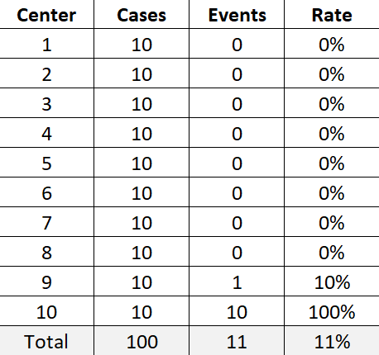
Interpretation
Overall VQI rate = 11/100 = 11%
75th Percentile = 0%
Center Rate is above the 75th percentile but less than the overall VQI rate
Notes:
To get a sense for how such examples can happen, suppose there were only 10 centers in the VQI with complication data as shown here.
The overall VQI rate would be 11/100 = 11%.
The 75th percentile would be zero because 75% of centers do indeed have a rate less than or equal to zero. In fact, 80% of centers have a rate less than or equal to zero.
Note then that Center 9’s rate of 10% is above the 75th percentile but less than the overall VQI rate of 11% -- just like we saw in the Open AAA wound complication example.

Slide 44
Interpretation
Many centers with complication rates of 0% (or process measure rates of 100%)
Good news for the practice
Challenging to split centers into meaningful quartiles
At least 75% of centers had a 0% rate
At least 90% of centers had a 0% rate
Center Rate ≤ 25th Percentile
“Top” 25th percentile
≈ 75% of centers
Center Rate ≥ 75th Percentile
“Bottom” 25th percentile
For low frequency adverse events, even a single event at your center should be of interest
Center Rate > 75th Percentile
“Bottom” 25th percentile
Any center with at least 1 event
Notes:
As you may have discerned from the previous example, such situations occur when many centers have complication rates of 0%, or many centers have process measure rates of 100%.
While this is good news for the practice, it becomes mathematically challenging to split centers into meaningful quartiles.
Consider these examples from the TCAR ASYMP dashboard.
For ipsilateral stroke, both the 25th and 75th percentiles are 0%, which tells us that at least 75% of centers had a 0% rate.
For the other measures shown here, 0% is the 90th percentile, indicating that at least 90% of centers had a 0% rate.
Now remember our rules for complication measures. If a center’s rate is less than or equal to the 25th percentile, the center is considered in the “top” 25th percentile.
But for ipsilateral stroke, at least 75% of centers had a 0% rate, so this “top” 25th percentile group actually comprises 75% of all centers. On the other hand, because 0% is also the 75th percentile, if we strictly adhered to the second rule listed here, every center would be assigned to the “bottom” 25th percentile.
We therefore remove the equality condition so that only centers with a rate strictly greater than the 75th percentile of 0% are assigned to the “bottom” 25th percentile.
Which of course means that any center with at least 1 event is assigned to the “bottom” 25th percentile. And this reflects the view that for low frequency adverse events, even a single event at your center should be of interest and a potential area for improvement.
Regarding this center’s results, while you can’t do better than an event rate of 0%, many other centers also had a rate of 0%, and this center would be well-served to not let their guard down and continue to monitor these results for future reports. And this brings up the important point that observing long-term trends over multiple reports is probably more important for informing quality improvement than observing the results of any single report.

Slide 45
Interpretation
Benchmarks
Several benchmarks to aid centers in setting targets or goals for quality improvement
Reasonable/Attainable
VQI Overall Rate
75th percentile
10th percentile
25th percentile
Aim for > 67% after the next quarterly report (3 months of new data)?
Aim for > 96% after the next 2 quarterly reports (6 months of new data)?
Local, center-level determinations
Aim for > 87% after the next 4 quarterly reports (1 year of new data)?
Aim for > 81% after the next 6 quarterly reports (1.5 years of new data)?
Notes:
If your center has observed a trend it would like to address, for example persistently low discharge medication rates, the dashboards provide several benchmarks to aid centers in setting targets or goals for quality improvement.
The VQI tends to encourage centers to reach the 75th percentile, which you can see was 96.3%.
But in general, you want your center’s goals to be reasonable and attainable. So, if a center has persistent historical rates of around 60% for discharge medications, it might not be feasible to aim for greater than 96% after the next 2 quarterly reports.
It might be more feasible to instead target the overall VQI rate (which we can see is very close to the region rate) and aim for greater than 87% after the next 4 quarterly reports.
The center could also target just getting out of the bottom 25th percentile and aiming for greater than 81% after the next 6 quarterly reports.
Or perhaps the center has modest, short-term goals and wants to target the 10th percentile and aim for greater than 67% after the next quarterly report.
Such determinations are best made locally, but centers have several benchmarks to guide their decision-making.
[End of Presentation]

