Slide 1
An Introduction to PSO Reporting
November 2021
Notes:
The purpose of this presentation is to provide a high-level introduction and overview of the various reports produced by the SVS PSO (Patient Safety Organization).
Users are encouraged to view this presentation in “Slide Show” mode for maximum benefit, as some slides contain layers of animation that may appear cluttered or overwhelming when viewed as a single slide with static content.
Narrative text is provided in the “Notes” section of each slide to further explain and clarify content, as necessary.

Slide 2
Overview
Various PSO Reports
Reporting Schedule
Embedded drill-down and data feedback
Notes:
The presentation will first focus on looking at various PSO reports and what each has to offer, in addition to the reporting schedule.
The focus will then shift to the embedded drill-down and data feedback functionality utilized in the reports.

Slide 3
Various PSO Reports
VQI Best Practices Dashboard
VQI Regional Quality Report
VQI Quality Initiative Update
VQI Participation Awards
Quality Initiative Updates are provided for centers to evaluate their data in preparation for the Participation Awards at the end of the year
For all PSO reports…
Notes:
The PSO produces 4 distinct reports.
Note that the VQI Quality Initiative Updates feed into the VQI Participation Awards by providing feedback for centers prior to the participation awards at the end of the year.
For all PSO reports, only active users at a center have access to the center’s reports, and the PSO does not share reports with any third-party entities. To be clear, these reports are not for public reporting or pay-for-performance, and they are not intended to “ding” centers. The reports are strictly for internal use by centers to improve patient safety and monitor, facilitate, and drive quality improvement in their respective institutions.

Slide 4
Various PSO Reports
Collect data
Analyze data
Utilize Tools
Implement QI
VQI
Notes:
The VQI represents a continuous cycle of quality improvement whereby we collect data, we analyze data, and we utilize tools at our disposal to implement and drive QI.
PSO reports show up in two sections of this cycle – the whole point of PSO reporting is to analyze data and provide centers tools to utilize in their quality improvement endeavors.

Slide 5
Various PSO Reports
VQI Best Practices Dashboard
VQI Regional Quality Report
VQI Quality Initiative Update
VQI Participation Awards
5 per year
2 per year
3 per year
1 per year
5 + 2 + 3 + 1 = 11 reports per year
~ 1 report per month
Notes:
Frequency of PSO reports

Slide 6
VQI Best Practices Dashboard
Wealth of information
Procedure characteristics, preop measures, LOS, discharge status, outcomes, etc.
Outcomes
Process Measures
Complications
Peri-operative outcomes
IVCF is the notable exception
5 reports per year
4 Quarterly Reports
1 Cumulative Report
Notes:
VQI Best Practices Dashboard

Slide 7
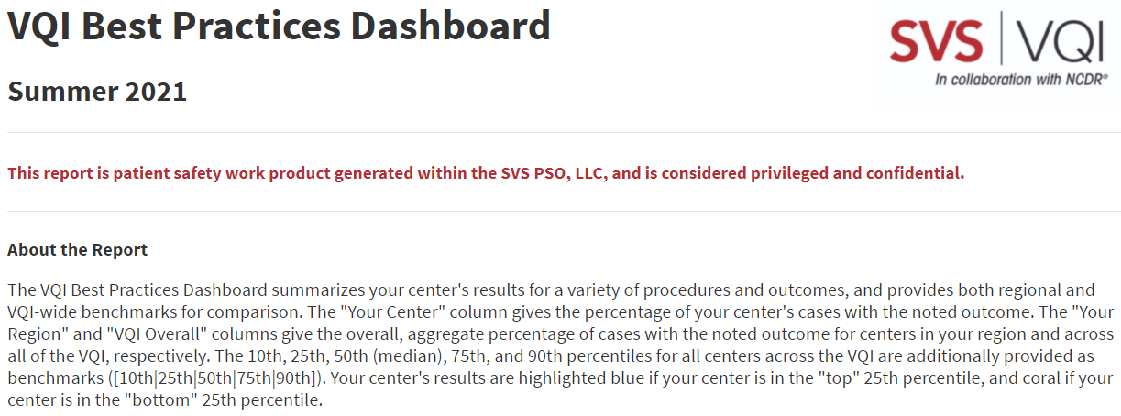
VQI Best Practices Dashboard
Quarterly (4 per year)
1-year procedure timeframe window
Incremented by 3 months every report
Examples
Spring 2021: Jan 2020 - Dec 2020
Summer 2021: April 2020 - March 2021
Fall 2021: July 2020 – June 2021
Winter 2021: October 2020 – September 2021
Notes:
Example of a quarterly report
For the quarterly reports, there is a 1-year procedure timeframe that is incremented by 3 months with every report. For example, the 2021 report timeframes are listed on this slide, where each is incremented by 3 months from the prior report.

Slide 8
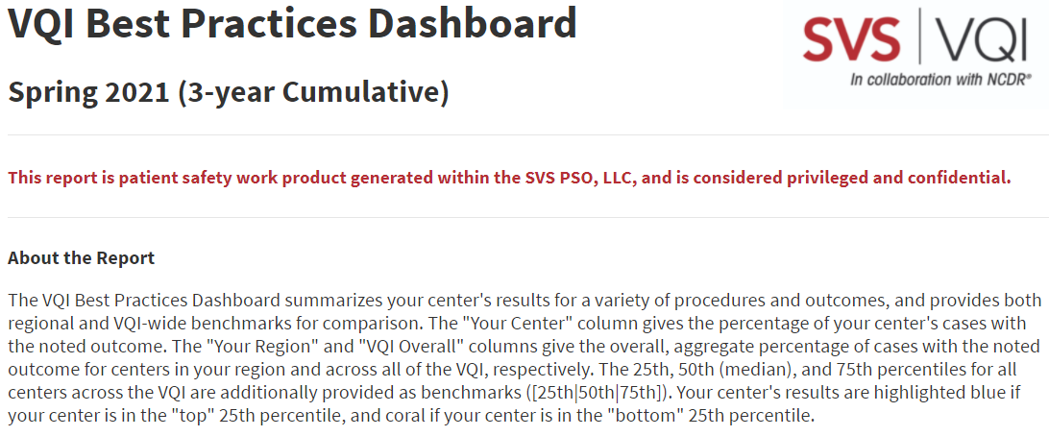
VQI Best Practices Dashboard
Cumulative (1 per year)
4-year procedure timeframe window (formerly 3-year as shown)
Incremented by 1 year every report
Examples
Spring 2022 (4-year Cumulative): Jan 2018 - Dec 2021
Spring 2023 (4-year Cumulative): Jan 2019 - Dec 2022
Spring 2024 (4-year Cumulative): Jan 2020 - Dec 2023
Notes:
Example of a cumulative report, produced once per year
For the cumulative report, there is a 4-year procedure timeframe (formerly 3-year as shown for the Spring 2021 cumulative report) that is incremented by 1 year with every report. For example, the Spring 2022 cumulative report will cover cases from 2018 to 2021, the Spring 2023 cumulative report will cover cases from 2019 to 2022, etc.

Slide 9
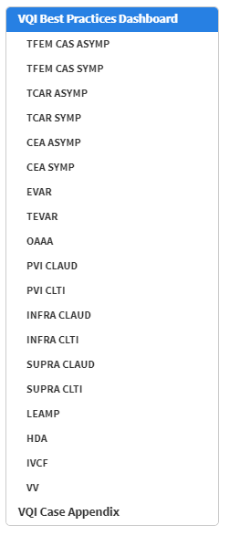
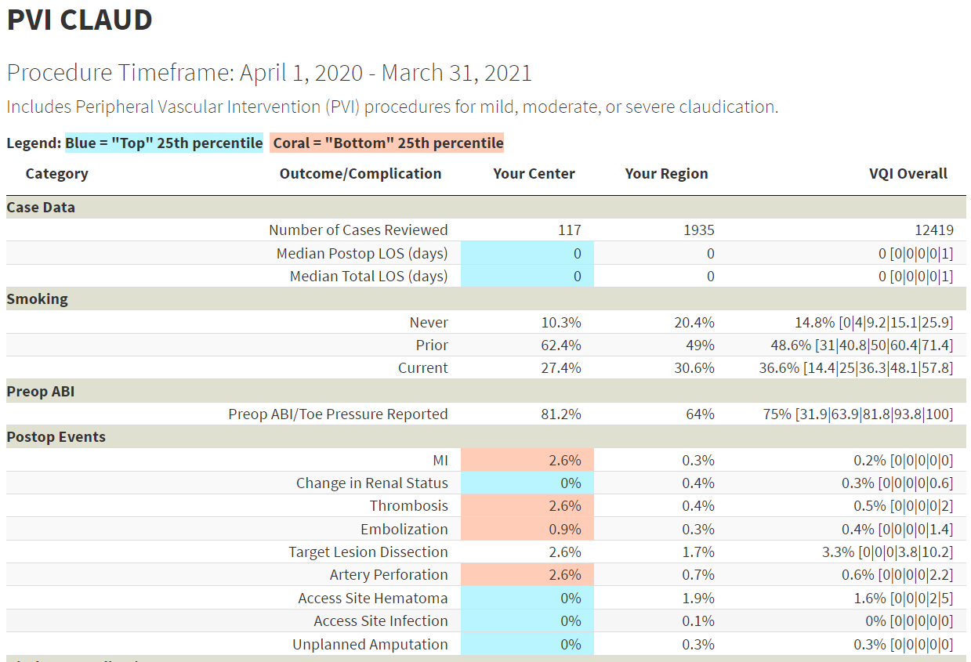
VQI Best Practices Dashboard
Table of contents for navigation
Overall % [10th|25th|50th|75th|90th]
Notes:
The VQI Best Practices Dashboard, and indeed all PSO reports, are interactive .html files (i.e., they open in a web browser) that contain a table of contents for navigation.
Individual dashboards (e.g., PVI CLAUD) can be accessed by clicking on the respective names in the table of contents. For example, clicking on PVI CLAUD in the table of contents will direct users to the PVI CLAUD dashboard pictured in this slide.
The procedure timeframe, as well as the inclusion/exclusion criteria, are given at the top of each dashboard.
Center results, as well as regional and VQI Overall benchmarks are provided.
The aggregate, overall VQI rate is given, as well as the 10th, 25th, 50th (median), 75th, and 90th percentiles among all VQI centers.
For example, 25% of VQI centers had a Preop ABI/Toe Pressure rate <= 63.9%. Similarly, 75% of VQI centers had a rate <= 93.8% (which means 25% of VQI centers had a rate >= 93.8%).
Center results are highlighted if the center is in the “top” 25th percentile or “bottom” 25th percentile
For process measures, a center is in the “top” 25th percentile if its rate is greater than or equal to the given 75th percentile. Similarly, a center is in the “bottom” 25th percentile if its rate is less than or equal to the given 25th percentile.
For complications/adverse events, a center is in the “top” 25th percentile if its rate is less than or equal to the given 25th percentile. Similarly, a center is in the “bottom” 25th percentile if its rate is greater than or equal to the given 75th percentile.

Slide 10
VQI Regional Quality Report
Cornerstone of VQI regional quality group meetings
Targeted, comparative results and benchmarks
Currently 23 key measures
Peri-operative outcomes and long-term (9-21 month) outcomes
Process measures and complications
2 reports per year (Spring and Fall)
Notes:
VQI Regional Quality Report

Slide 11
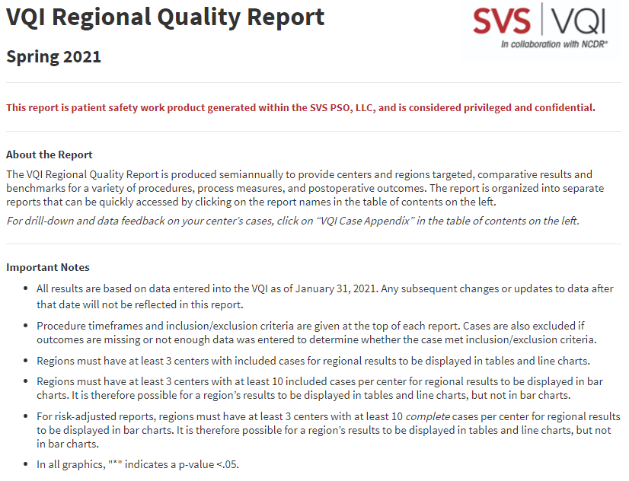
VQI Regional Quality Report
Semiannual (2 per year)
1-year procedure timeframe window
Procedure timeframe for long-term outcomes is 2 years behind procedure timeframe for peri-operative outcomes
Incremented by 6 months every report
Examples
Spring 2021: Jan 2020 - Dec 2020
Fall 2021: July 2020 - June 2021
Spring 2022: Jan 2021 – Dec 2021
Notes:
VQI Regional Quality Report
There is a 1-year procedure timeframe that is incremented by 6 months with every report (i.e., 6 months of new data with each report). For example, the report timeframes listed in this slide are each incremented by 6 months from each prior report.
Note that the procedure timeframe for long-term outcomes is 2 years behind the procedure timeframe for peri-operative outcomes (21 months for collection + 3 months for abstraction = 24 months = 2 years).

Slide 12
VQI Regional Quality Report
Table of contents for navigation
Reports for 23 key measures
All have the same structure
5 components
Report Description
Comparison Table
Line Chart
Center Variation Chart
Regional Variation Chart
Notes:
Individual reports can be accessed by clicking on the respective names in the table of contents
The first four reports provide a high-level summarization of results, procedure volume information, and physician specialty information.
The other reports reflect 23 key measures where comparative results and benchmarks are given. Each of these 23 reports have the same structure and the same five basic components
- Report Description
- Comparison Table
- Line Chart
- Center Variation Chart
- Regional Variation Chart

Slide 13
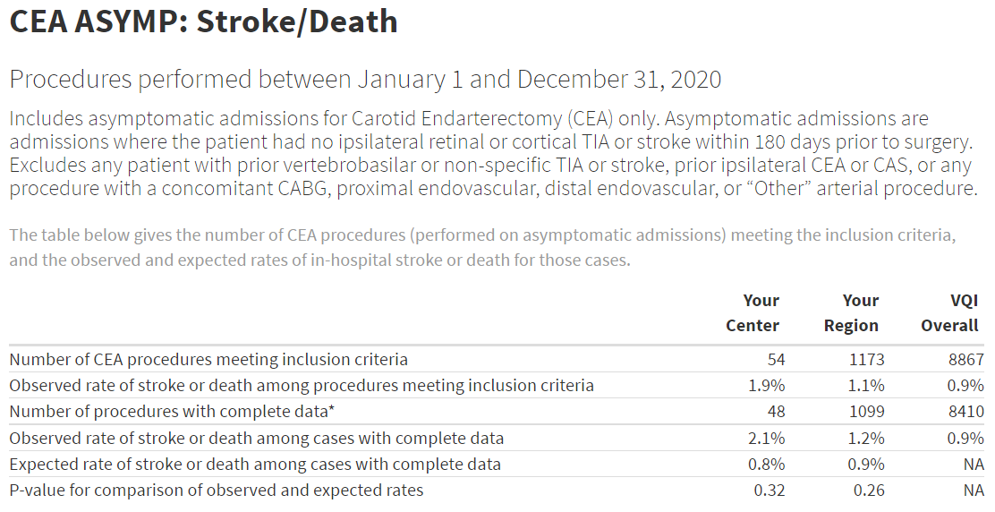
VQI Regional Quality Report
Report Description & Comparison Table
Report Description
Procedure Timeframe
Inclusion/Exclusion Criteria
Outcome definition
Comparison Table
Notes:
Report Description and Comparison Table
At the top is the report description, which includes the procedure timeframe, the inclusion/exclusion criteria for the report, as well as the outcome definition.
Below the report description is the comparison table, which provides results for your center, your region, and the VQI overall.
The last 4 rows of this report pertain to risk-adjustment, so for non-risk-adjusted reports only the first 2 rows are displayed.

Slide 14
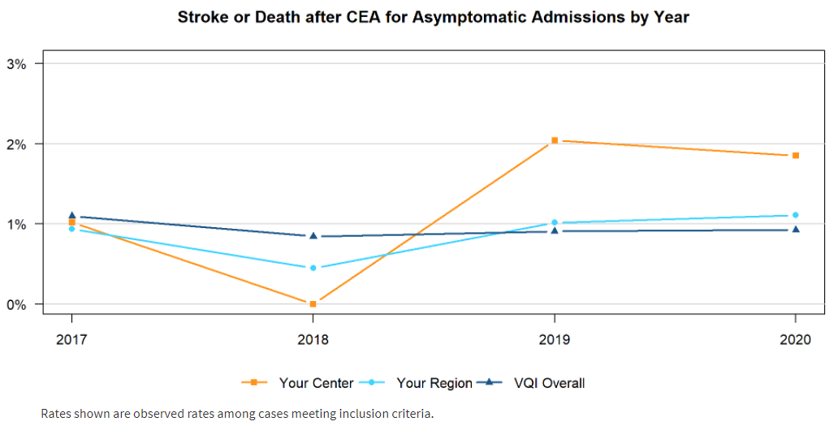
VQI Regional Quality Report
Line Chart
Yearly rates over a 4-year timeframe
Notes:
Line Chart
The line chart provides yearly rates over a 4-year timeframe for your center, region, and VQI overall. Note that the comparison table represents only the most recent year of data, circled in red on this slide.

Slide 15
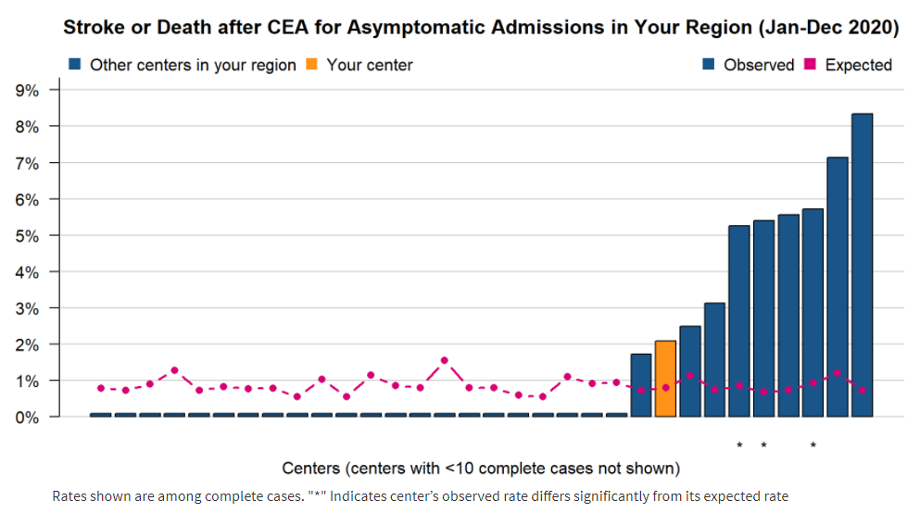
VQI Regional Quality Report
Center Variation Chart
Center rates within your region
Notes:
Center Variation Chart
The center variation chart provides blinded center rates within your region (with your center highlighted in orange – only your center can see this highlighting).
The expected rates (circled in red on the slide) pertain to risk-adjustment, so for non-risk-adjusted reports these will not be displayed.

Slide 16
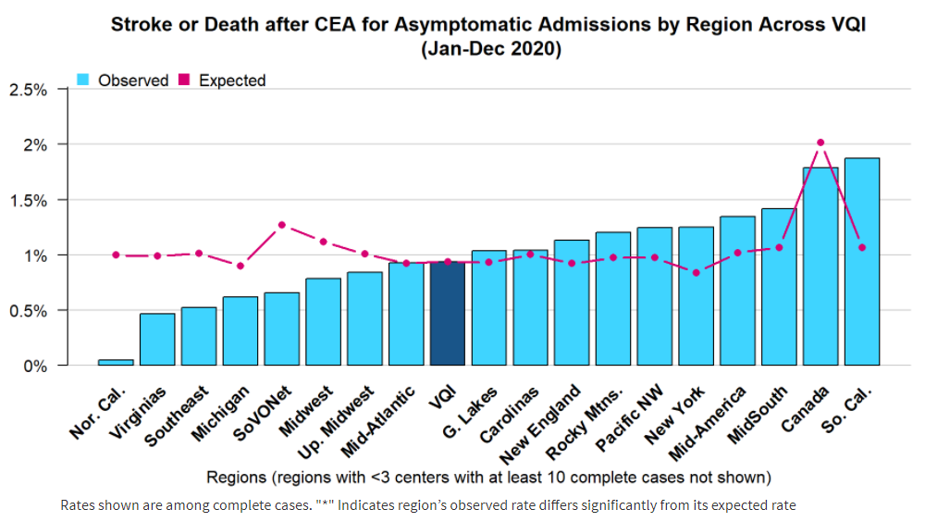
VQI Regional Quality Report
Regional Variation Chart
Regional rates across VQI
Notes:
Regional Variation Chart
The regional variation chart provides regional rates across VQI.
The expected rates (circled in red on the slide) pertain to risk-adjustment, so for non-risk-adjusted reports these will not be displayed.

Slide 17
VQI Quality Initiative Update
Updates on VQI National Quality Initiatives
Discharge Medications (DC Meds)
EVAR Sac Diameter Reporting
Intended to provide rapid data-feedback for centers to evaluate their data ahead of the participation awards
3 reports per year
Notes:
VQI Quality Initiative Update
The basic idea behind these reports is to provide centers updates on VQI National Quality Initiatives (DC Meds and EVAR Sac Diameter Reporting)
They are intended to provide rapid data-feedback for centers to evaluate their data ahead of the participation awards (and regional quality reports) at the end of the year.

Slide 18
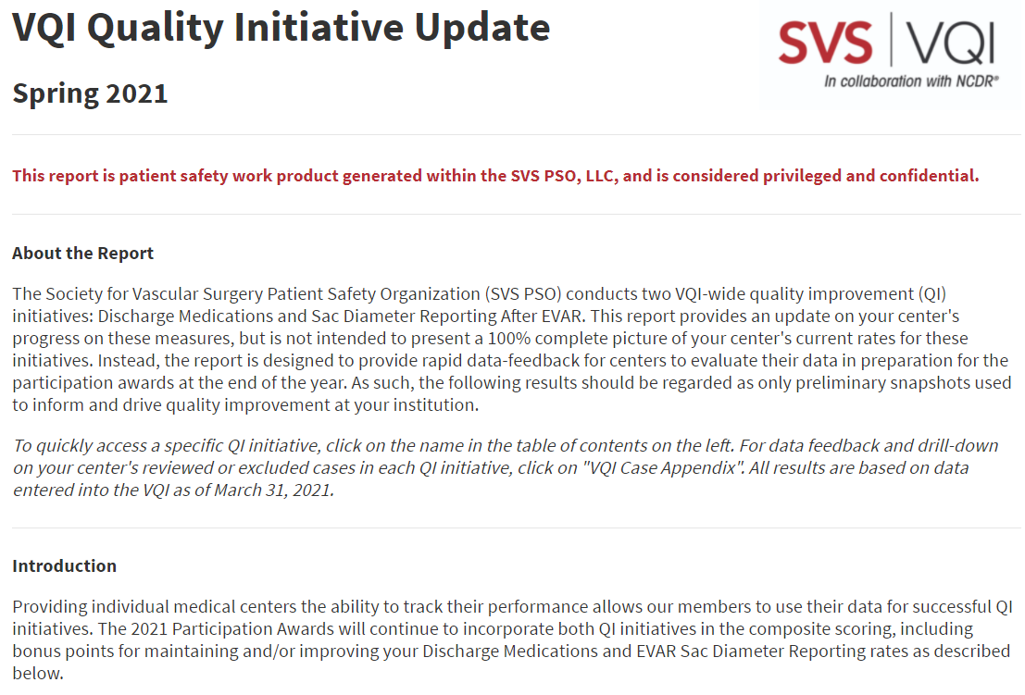
VQI Quality Initiative Update
2021 Quality Initiative Updates
Spring 2021
DC Meds: 2021 cases through Q1
Summer 2021
DC Meds: 2021 cases through Q2
Fall 2021
DC Meds: 2021 cases through Q3
EVAR: 2019 cases as of Q1 2021
EVAR: 2019 cases as of Q2 2021
EVAR: 2019 cases as of Q3 2021
2021 Participation Awards
DC Meds: 2021 cases
EVAR : 2019 cases
Notes:
To see how the Quality Initiative Updates feed into the participation awards, consider the upcoming 2021 Participation Awards that will be released in early 2022.
For the 2021 Participation Awards, centers can earn bonus points for their performance on DC Meds (2021 cases) and EVAR Sac Diameter Reporting (2019 cases). In anticipation of the 2021 Participation Awards…
The Spring update provides feedback for DC Meds on 2021 cases through Q1
The Summer update provides feedback for DC Meds on 2021 cases through Q2
The Fall update provides feedback for DC Meds on 2021 cases through Q3
And of course, EVAR sac diameter feedback is provided for 2019 cases as of each successive quarter
Note that the same data is used for the Participation Awards and the Spring Regional Quality Report, so this evaluation of data ahead of the Participation Awards also serves to prepare centers for the Spring Regional Quality Report.

Slide 19
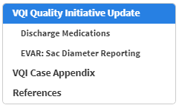
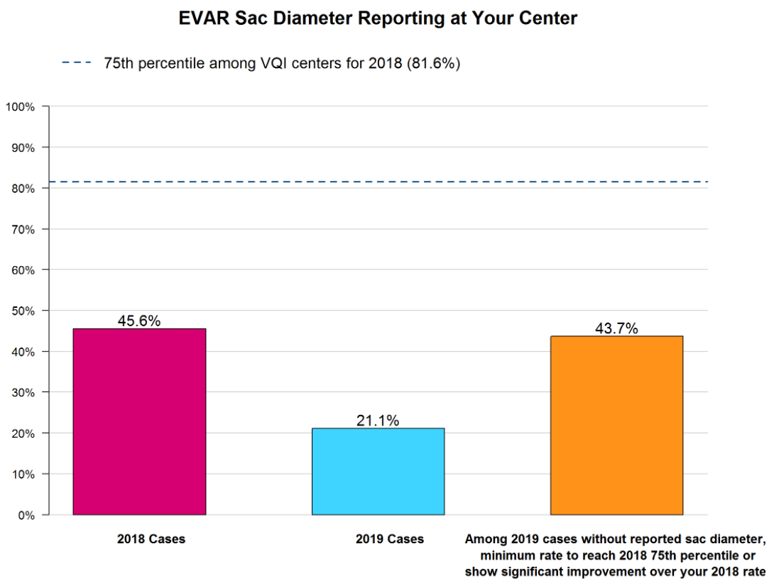
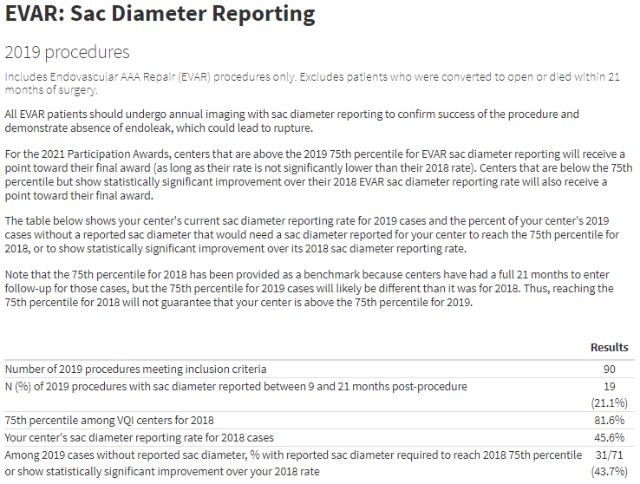
VQI Quality Initiative Update
Notes:
There is a table of contents for navigating the report. For example, clicking on the EVAR: Sac Diameter Reporting link will direct users to the content given in this slide, where a table, as well as a graphical description, of center results is displayed.

Slide 20
VQI Participation Awards
Recognize the importance of active participation in the VQI
1 report/award per year
Notes:
VQI Participation Awards

Slide 21
VQI Participation Awards
Based on 4 scoring domains
Long-Term Follow-up (40%)
Regional Meeting Attendance (30%)
Quality Improvement Activities (20%)
Number of VQI Registry Subscriptions (10%)
Notes:
A center’s award is based on 4 scoring domains, with each domain weighted as seen on the slide.
Note that the Quality Improvement domain is where centers have the opportunity to earn bonus points for performance on national quality initiatives.

Slide 22
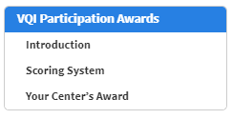
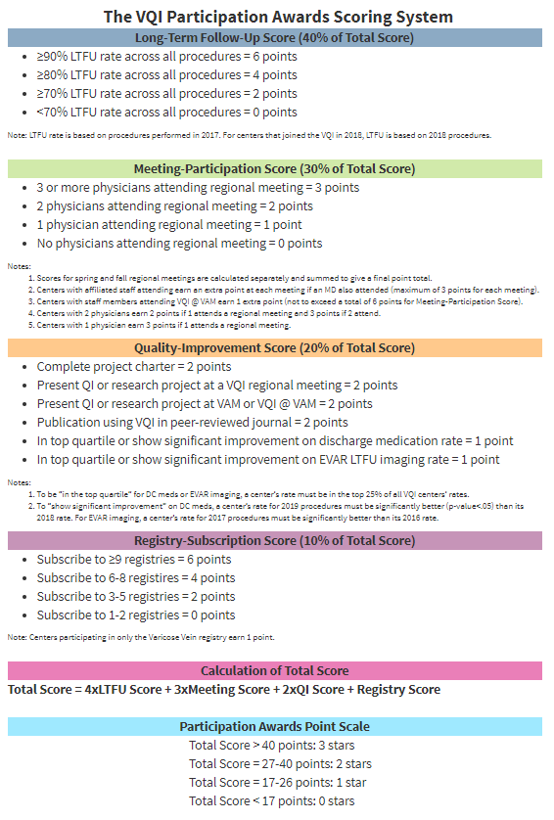
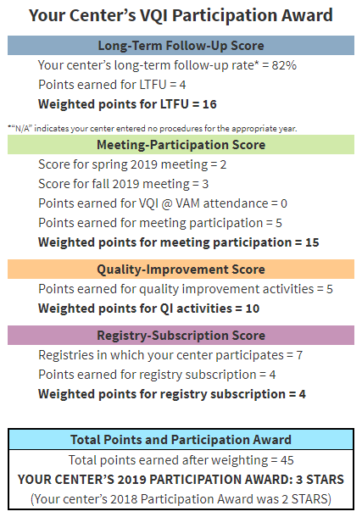
VQI Participation Awards
Notes:
There is a table of contents for navigation in the report, where centers can quickly access the scoring system description as well as the center’s award.

Slide 23
Various PSO Reports
Reporting Schedule
vqi.org/resources/reporting
Notes:
There is a reporting schedule users can access anytime via the VQI reporting website (vqi.org/resources/reporting)
After navigating to the VQI reporting website, users will see a link (circled in red on this slide) that will direct them to the reporting schedule, which is updated yearly in the fall.

Slide 24
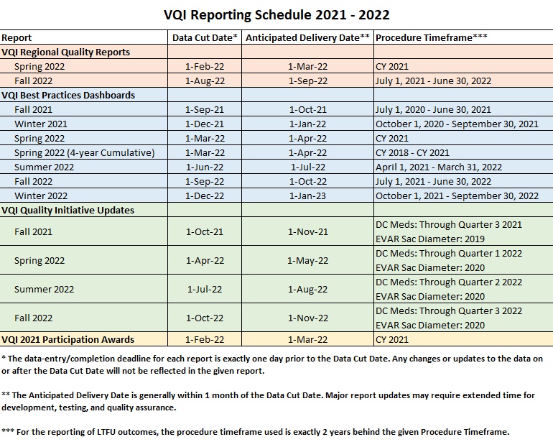
Various PSO Reports
Notes:
Screenshot of the VQI Reporting Schedule

Slide 25
Embedded drill-down and data feedback
Collect data
Analyze data
Utilize Tools
Implement QI
VQI
Notes:
To motivate the topic of embedded drill-down and data feedback, consider again the continuous cycle of quality improvement that the VQI represents. Just having your center’s data analyzed is not sufficient to move through this cycle. That is, just looking at the PSO reports and calling it a day isn’t enough. Centers need to be able to use their data – to drill-down into the data, to identify which patients had certain events, and efficiently use this information to drive quality improvement.
In other words, centers need to be able to utilize tools, in conjunction with the data that has been analyzed, to implement QI. This is precisely what the embedded drill-down and data feedback functionality in PSO reports was designed to facilitate.

Slide 26
Embedded drill-down and data feedback
Embedded drill-down and data feedback
Identify included/excluded cases
Identify cases with each noted outcome
Download this information
It’s all contained in the report!
No need for a separate platform or web link
Notes:
“Drill-down” refers to the ability to identify included/excluded cases, as well as cases with each noted outcome (e.g., What patients had a postop stroke? What patients didn’t get DC Meds? What patients didn’t have an EVAR Sac Diameter reported?, etc.).
“Data feedback” means providing this information to centers in a nice package that can be easily downloaded and efficiently used for quality improvement efforts.
And finally, “Embedded” means that it’s all contained in the report. There is no need for a separate platform or web link – no jumping through hoops just to get data back.

Slide 27
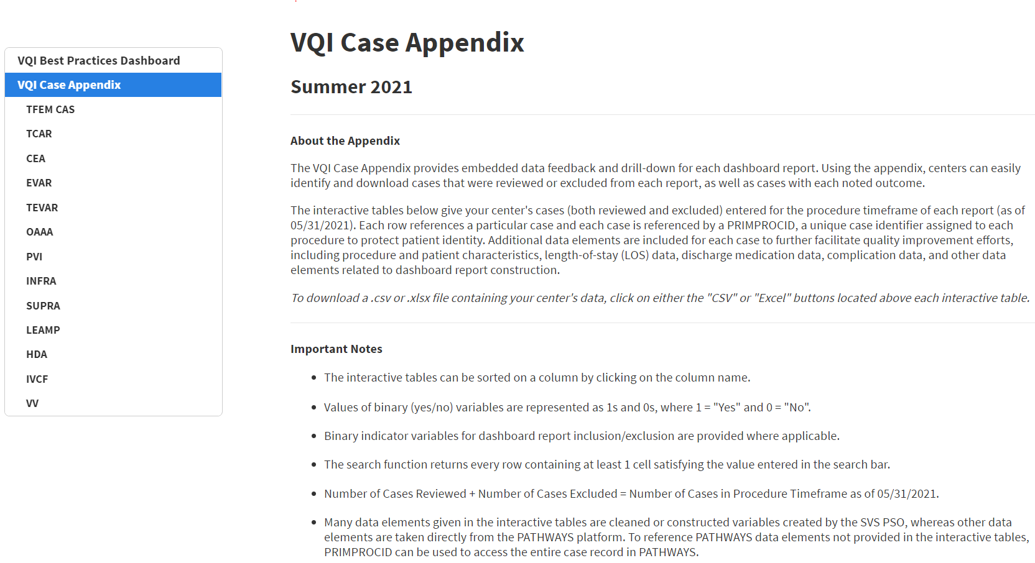
Embedded drill-down and data feedback
VQI Case Appendix
Contains interactive tables you can download as an excel or .csv file
Notes:
Embedded drill-down and data feedback is provided in the form of interactive, downloadable tables.
These tables are found in the VQI Case Appendix of each report, which has a dedicated section in the report’s table of contents.
As seen in this slide from the VQI Best Practices Dashboard, clicking on any of the sub-headings in the VQI Case Appendix will direct users to the corresponding interactive drill-down table. For example, the selection shown on this slide will direct users to the drill-down table that corresponds to the INFRA dashboards.

Slide 28
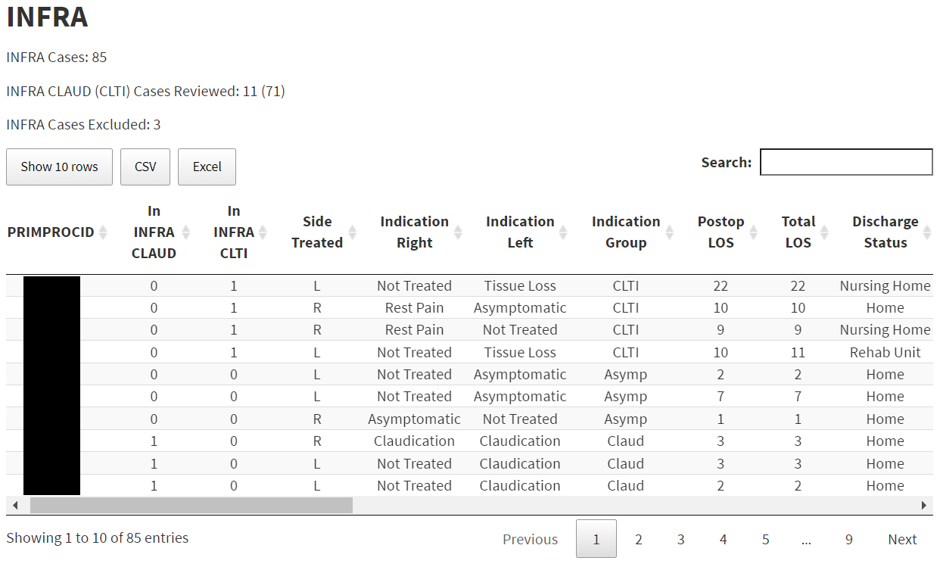
Embedded drill-down and data feedback
Total # of cases in procedure timeframe
# of cases included in each report
Change the # of rows for display
# of cases not included in either report (note: 3+11+71=85)
Returns every row containing at least 1 cell satisfying the value entered in the search bar
Binary indicators for report inclusion
(1=yes, 0 = no)
Download the table as .csv or .xlsx file
Sort on any column by clicking the double arrows
Use scroll bar to see additional variables
Click to page thru your cases
Notes:
Drill-down table
The total number of cases in the procedure timeframe is given at the top, and this matches the number of entries (rows) in the table.
Every row in the table represents a case, and cases are indexed by PRIMPROCID, a unique case identifier assigned to each procedure to protect patient identity.
The default display is 10 rows, but the number of rows displayed (10, 25, 50, 100, 250, or 500) can be changed.
Users can also page thru their center’s cases.
Buttons can be used to download either a .csv or .xlsx file containing all of the data in the interactive table.
The number of cases included in each dashboard is given, as well as the number of cases not included in either dashboard (note 3+11+71=85).
Specific cases that were included/excluded in each dashboard can be identified using binary indicators…
(In INFRA CLTI = 1) → Included in the INFRA CLTI dashboard
(In INFRA CLAUD = 1) → Included in the INFRA CLAUD dashboard
(In INFRA CLTI = 0 and In INFRA CLAUD = 0) → Not included in either dashboard
The scroll bar can be used to see additional columns/variables in the table.
The table can be sorted on any column by clicking the double arrows
The search function can be helpful when looking for a specific PRIMPROCID. It returns every row containing at least 1 cell satisfying the value entered in the search bar.

Slide 29
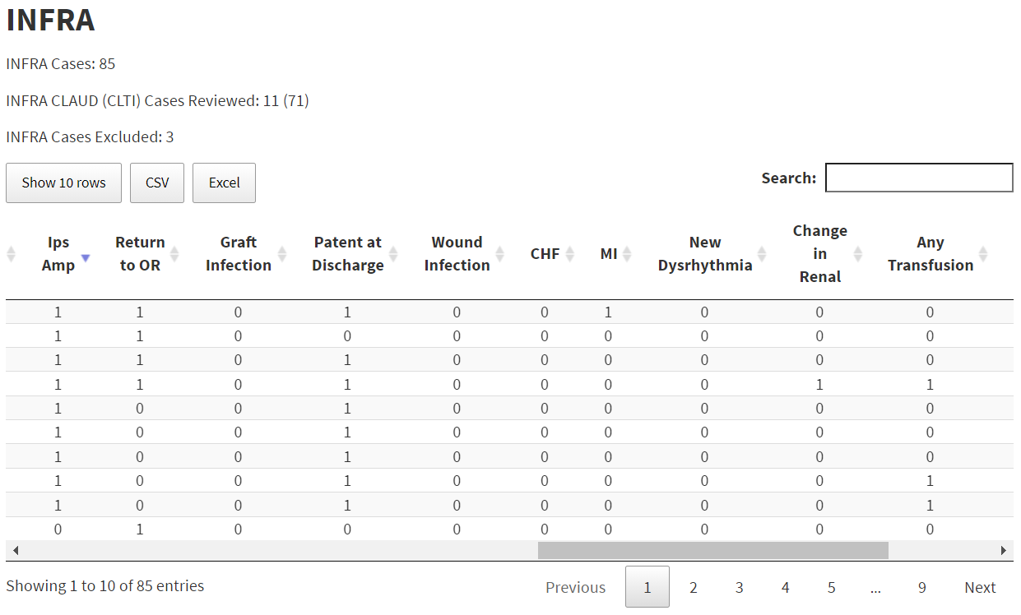
Embedded drill-down and data feedback
Notes:
Even these simple features can be useful.
In this slide, the scroll bar has been used to scroll over to some of the outcomes given in the table. By sorting on Ips Amp (Ipsilateral Amputation), one can quickly identify the 9 cases that had this event. Note that 1 of these cases also had a postop MI.

Slide 30
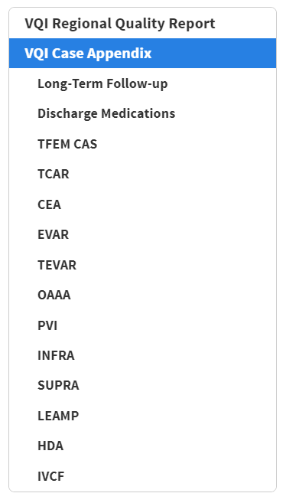
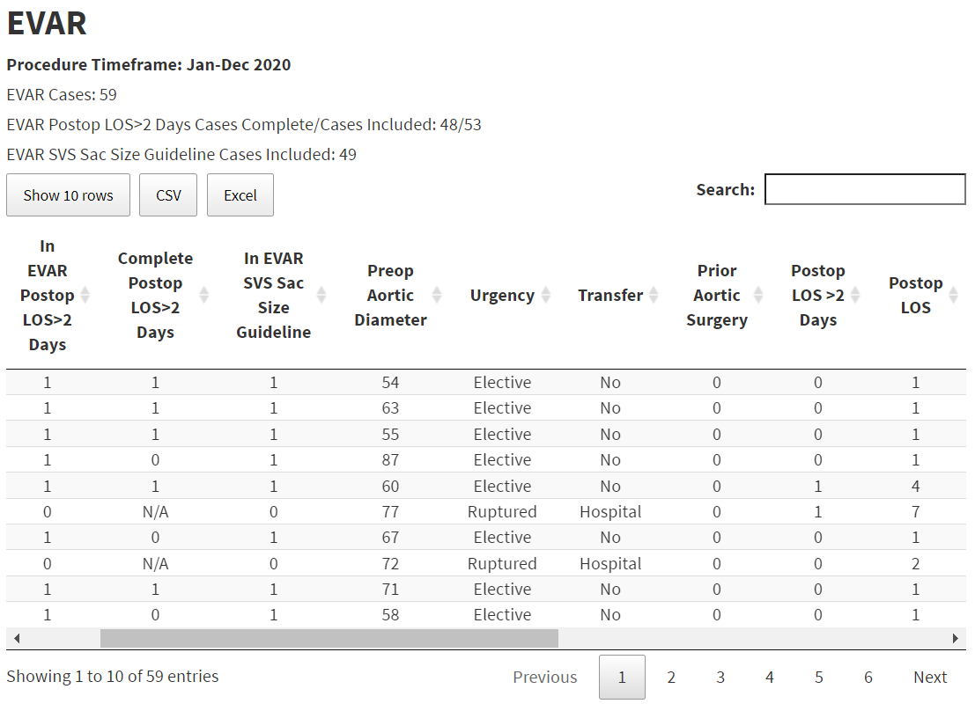
Embedded drill-down and data feedback
53 cases in EVAR Postop LOS>2 Days report, of which 48 have complete data for risk-adjustment
Binary indicator for cases with complete data
Binary indicators for report inclusion
(1=yes, 0 = no)
Notes:
The drill-down tables in the Case Appendix have similar structures throughout all PSO reports, though there are some notable differences. In this slide the EVAR drill-down table from the Regional Quality Reports is pictured.
As before, there are binary indicators in the table for report inclusion/exclusion.
Some of the reports in the Regional Quality Reports are risk-adjusted, so the number of included cases is given, as well as the number of cases with complete data (cases that have non-missing values for all risk-adjustment variables used in the model). As pictured in this slide, 53 cases were included in the EVAR Postop LOS>2 Days report, of which 48 had complete data for risk-adjustment.
There is also a binary indicator to determine which cases had complete data…
(Complete Postop LOS>2 Days = 1) → This case had complete data for the Postop LOS>2 Days report
(Complete Postop LOS>2 Days = 0) → This case did not have complete data for the Postop LOS>2 Days report
(Complete Postop LOS>2 Days = N/A) → This case was excluded from the Postop LOS>2 Days report, so the completeness indicator is N/A
Lastly, note the binary Postop LOS>2 Days report outcome (Postop LOS >2 Days), as well as the raw Postop LOS number (Postop LOS).

Slide 31
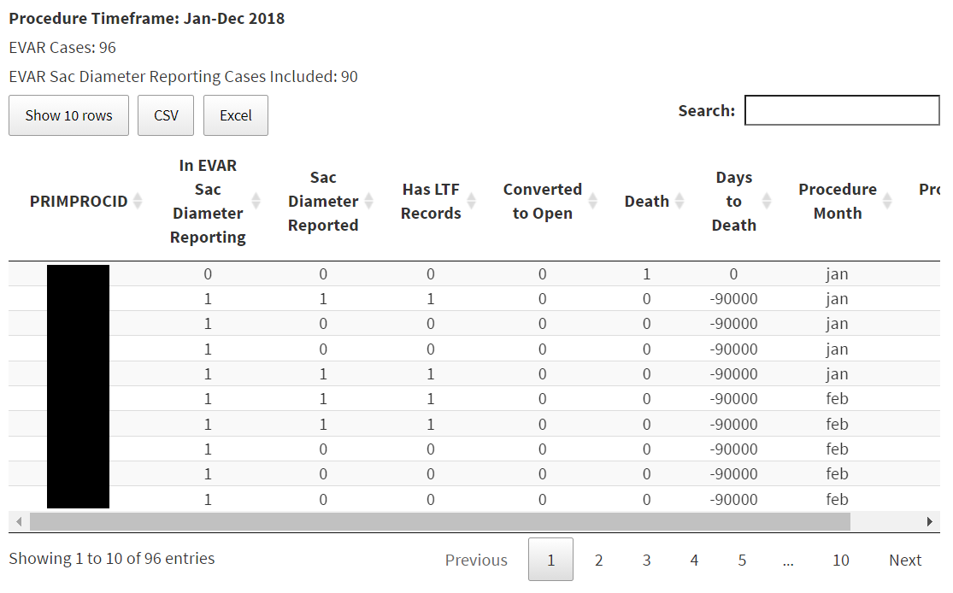
Embedded drill-down and data feedback
Notes:
There is a separate drill-down table for EVAR Sac Diameter Reporting. Because EVAR Sac Diameter Reporting is a long-term follow-up outcome, the procedure timeframe is 2 years behind the usual/standard procedure timeframe, so a separate table is provided for simplicity/book-keeping.
As before, the number of included cases is given, as well as a binary indicator for report inclusion (In EVAR Sac Diameter Reporting) and the binary report outcome (Sac Diameter Reported).
[End of Presentation]

